Slide 1
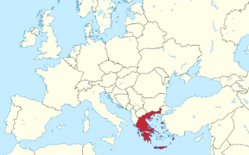
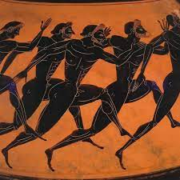
Year 4 Summer Term 1 History
What elements of Ancient Greek civilisation are still used today?
Beliefs were important in
Ancient Greece and they
believed in many Gods and
Goddesses.
Ancient Greeks were
story tellers and many of their
myths are still told today.
Greece has a mainland connected to Europe with thousands of islands.
rivalries – competitions or fights between two people in the same area or who want the same things.
century – a period of 100 years.
democracy – a government where people choose their leader by voting.
Athens developed a new system of government called democracy, like we have today, where ordinary citizens can vote on changes to the law.
navy – a type of army that fights at sea and on boats.
Key Questions:
How does the Ancient Greek civilisation fit into the chronology of world history?
What is democracy and how did the Ancient Greeks govern and rule?
What was it like to live in ancient Greece? Was society fair?
What was important to the ancient Greeks?
What do we still use today that started in Ancient Greece?
chamber pot – a round container that Greeks used for a toilet.
Greek houses were similar to ours today, built with mud bricks not stone.
abandoned – something or someone left on their own.
originate – where something comes from or begins.
myths – well known stories told to explain nature or beliefs.
The first Olympic games was held at Olympia in 776BC, they were held for 100 years. In 1896 the games were brought back and still continue today.
architecture – the art of planning, design and constructing buildings.
atoms – the smallest part of matter that can take part in a chemical reaction.

