Slide 1
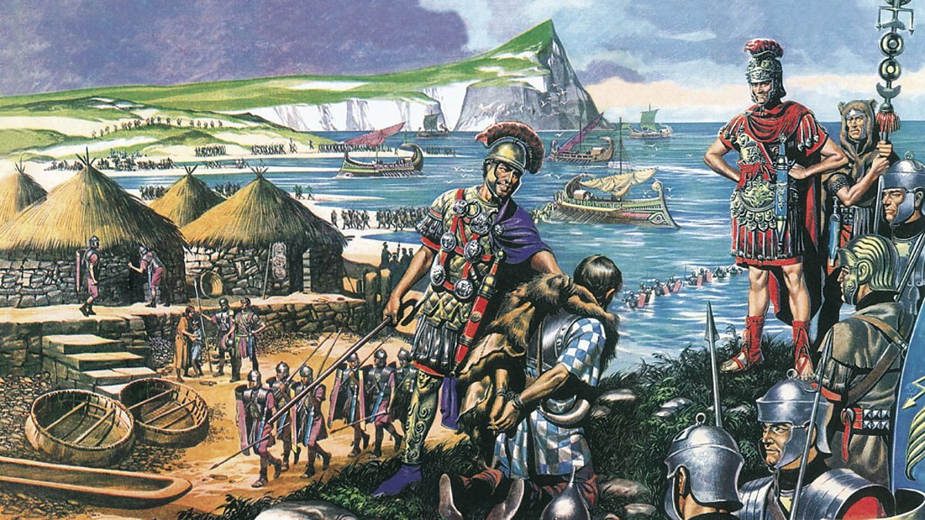


English
In English we will be reading ‘The Boy at the Back of the Class’ by Onjali Q Rauf. We will explore a range of writing techniques including a character description and letter writing. We will explore the features of each text type and then apply these in our independent writing.
We will develop our knowledge of Year 4 spelling, grammar and punctuation through our English lessons and Quick SPAG. We will be expected to use these independently in our writing
Spelling rules will be taught weekly.
During all lessons, we will continue to focus on a high standard of presentation, including joined handwriting
Curriculum – R.E.
This half term in Year 4, our R.E. enquiry question will be:
“How do people show commitment to God?’
We will be exploring how special the relationship is between Jews and God and the best way the Jews can show commitment to God. We will also explore the significant parts of the Nativity story for Christians today.
Maths
In Year 4 this term we will continue to consolidate our previous maths learning every week. New learning will consist of area and multiplication and division. Please continue to support your child to practise their recall of all times tables up to 12 x 12. We will be using TT Rockstars and Maths Shed to aid this. Your child will be working through a personal plan of times tables which they need to learn. The ability to recall these facts more confidently will support your child in the statutory Multiplication Tables Check in June.
Year 4 Newsletter
Autumn 2 2024
Science
This half term Year 4 will learn about ‘Solids, Liquids and Gases’ We will investigate their individual properties. As well as looking at evaporation and condensation. We will also find out about the water cycle.
Our PE Days
Our PE morning is every Wednesday. Please ensure that children have correct full outdoor and indoor PE kit in school all week. Long hair should be tied back and earrings removed as outlined in the school’s uniform policy on our website. Plasters over earrings are not permitted for health and safety reasons.
Learning Outcome
After this unit of RE learning, children will produce a report to demonstrate all that they have learnt.
Reading
Please continue to share the love of books with your child. Encourage them to read/share books at least 5 times per week. This should be recorded on one page per week of the Reading Record with a comment and appropriate details. Reads will be counted every Monday.
Reading should be a delightful experience, and we encourage you to revisit and re-read favourite books and stories.
Happy readers become confident readers.
Wider Curriculum
ICT – Digital Literacy and Information Technology (E-safety and Garage Band)
PSHE – Celebrating Differences
Music – Learning to play the violin
PE – Indoor Athletics and Netball with Body Management
DT – Levers and linkages
Homework
Each week the children will be set homework on a Friday to be submitted by the following Thursday. Homework is a choice menu that we hope allows flexibility for all parents and children.
Please send home learning in whenever it is finished and /or photographs or videos for us to share in school.
Please continue to share (on Dojo) anything you get up to outside of school that you would like to share.

