Slide 1
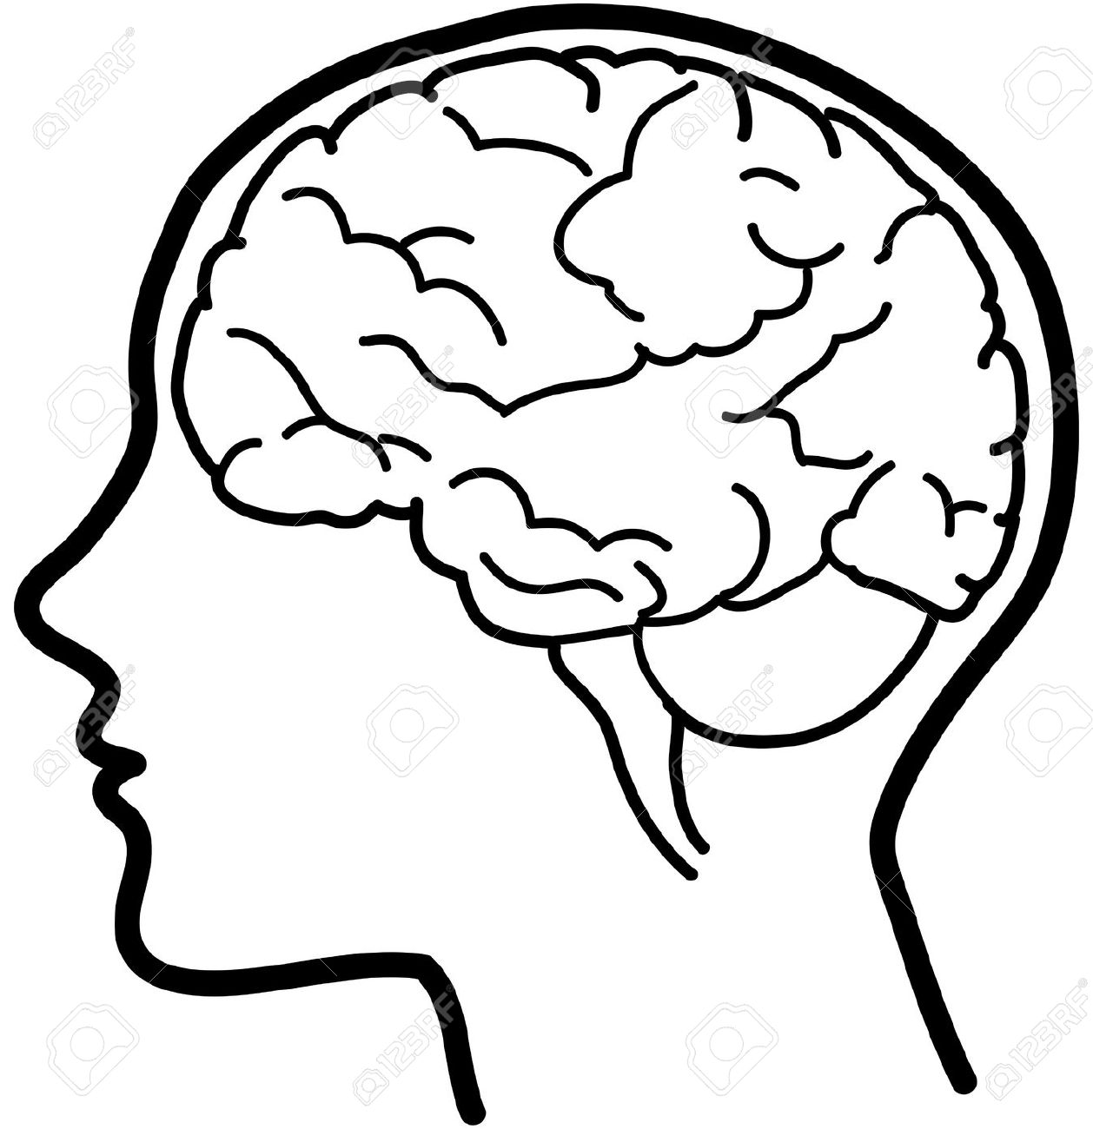
COMPUTING AT MIDDLETHORPE
Our computing curriculum
aims to offer a high quality curriculum which will inspire children and develop the necessary knowledge needed to become digitally literate and thrive in an increasingly changing and fast-paced world.
Big Ideas
Digital literacy (communication methods, research and reports, problem solving, typing, editing, formatting)
Identity (Identifying risks and consequences online, effect passwords and systems, understanding of social media, positive and negative impacts of digital technology).
Real World Links Real life applications of software and hardware, computer science, developing essential knowledge and know the benefits and limitations of information communication technology.
Content and Sequencing
Sequenced units that are structured so that they are revisited and further developed across the curriculum from EYFS to Year 6. Our curriculum contains content of the National curriculum and knowledge development that is relevant for today’s world
Computing in EYFS
Fundamentals of digital literacy, computer science and information technology
Computing in KS1
Units include typing skills, coding, online safety, photo editing and data handing
Units are taught in a sequential manner, building on previously taught knowledge and understanding, via the use of a range of technologies.
All units focus on developing and revisiting knowledge and understanding of prior learning.
Computing in KS2
Units include word processing, online safety, animation and drawing, presentations and data handing that are taught in a sequential manner, building on previous learning.
Acquired knowledge is continued to be built upon as children move through KS2 building towards children being digitally ready for KS3.
All units focus on developing and revisiting knowledge and understanding of prior learning.
Links with English and Maths
Every lesson is a reading lesson
High quality topics are chosen with links to the wider curriculum
Expression of knowledge, investigations and opinions both orally, digitally and in written form
Directional language, co-ordinates, statistics, a wide range of text types and styles are covered.
Retrieval Practice
Knowledge, understanding and vocabulary identified
Low stakes quizzing to develop long term memory
Key concepts identified (above) and are revisited
Key ideas are investigated by considering what they are and what they are not
Links across year groups for retrieval of knowledge
Outcomes
All units begin a learning outcome which children should be able to demonstrate at the end of the unit
End of the unit children with complete a task or take part in a discussion which gives them the opportunity to apply or discuss their computational knowledge and understanding
Self evaluation of end of unit task and teacher assessment
Support
Everyone has access to the Computing National Curriculum.
Support is provided for those learners who require it.
Considerations is given for learners who grasp concepts more rapidly.

