Slide 1
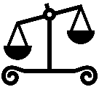
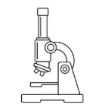
Balanced Forces – Forces in opposite direction are equal.
Unbalanced Forces – Forces in opposite direction are not equal.
Mechanism – System of parts working together in a machine.
Levers
Pulleys
Balanced and unbalanced
Gravity – a force pulling an object towards the centre of the Earth.
Gears
Mechanisms
Newton
Weight
Weight – The force put on the mass of an object by gravity
Mass – The quantity of matter which a body contains
Force – something that changes the motion of an object.
Forces
Gravity
Mass
Forces
Air Resistance – Forces that are against the motion of an object as it passes through the air.
Friction
Tower of Pisa
Experiment
Friction – the resistance that an object has when moving over a surface.
Air resistance
Galileo
Water resistance
Streamlined
Streamlined
Streamlined – designed to have very little resistance to the flow of air or water.
Water Resistance - Forces that are against the motion of an object as it passes through water.

