Slide 1
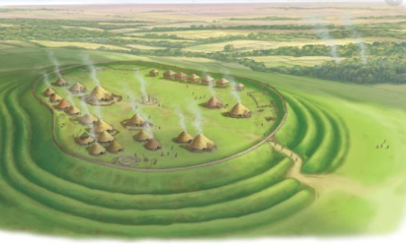
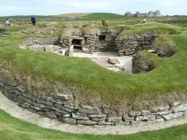
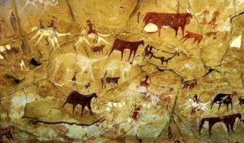
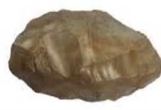
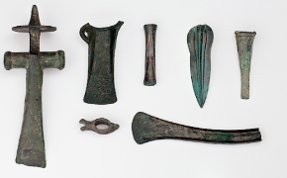
Y3 Autumn 1 2023
How do we know what it was like to live in the Stone Age, Bronze Age and Iron Age?
Hillfort
Vocabulary Dozen​
archaeologist​ | Person who learns about the past by digging up artefacts and studying them. ​
primary source​ | The main source of information about a topic. ​
period​ | A length of time covering many years. ​
settlement​ | A place where a group of people live together in many buildings. ​
forage​ | To search for food. ​
preserve​ | To keep something in good condition. ​
monument​ | Something built to remember an important person or event. ​
trading​ | The act of buying and selling goods and services (for example food). ​
alliances​ | A group of countries or groups of people who work together.​
tribes​ | A group of people that live together for protection. ​
hill forts​ | A settlement surrounded by ditches. ​
invade​ | To enter another country by force. ​
The Stone Age It was a very long period of time. Split into three periods: Palaeolithic (The Old Stone Age - Prehistoric), Mesolithic (Middle Stone Age) Neolithic (New Stone Age). People were hunter-gatherers and were nomadic until they began farming. People lived in Europe for the first time. Stone tools used.
The Bronze Age Bronze was used instead of stone to make tools and weapons in 2500BC People were buried with their important possessions. People started to farm the land.
The Iron Age Iron was used instead of Bronze to make tools and weapons as its shape could be changed. Settlements were often under attack and there were many wars. They lived in tribes in hillforts for protection. 43AD - The Romans invaded Britain.
Skara Brae, Scotland | Well preserved Stone Age village in Orkney, Scotland. One room in each of the 8 houses made of stone.
Stonehenge, England | Famous Stone Age monument located in Wiltshire. Circle of very large stones standing upright Some people believe it was built to learn about the movements of the Sun and Moon. Some people believe it was a burial ground.
Cave Paintings
Flint
Bronze Tools

