Slide 1
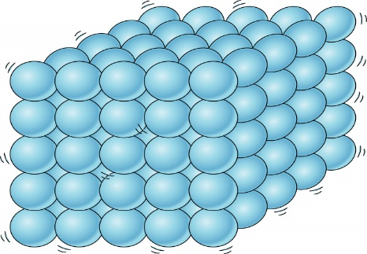
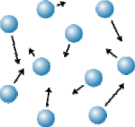
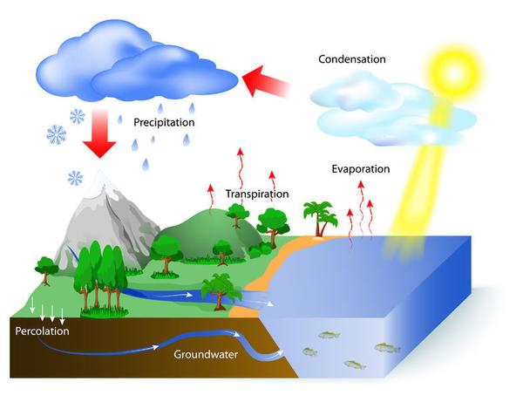
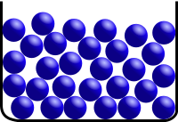
Year 4 – States of Matter
Solids
Solids keep their shape well and don’t flow or spread out on their own.
Solids always take up the same amount of space.
Particles sit closely together.
They move a little but keep in the same position.
Vocabulary Dozen
solids | Solids keep their shape well and don’t flow or spread out on their own
liquids | They aren’t firm and they flow and can be poured easily
gases | Has no particular shape and can drift easily
evaporation | The change that happens when a liquid turns into a gas
condensation | The change that happens when a gas turns into a liquid
Water cycle | The way water moves around the planet by changing state
temperature | Is a measure of how hot or cold something is
Degrees Celsius | The unit by which temperature is measured
particles | Tiny bits of matter that make up everything in the universe
condensed | The process of a gas turning into a liquid
thermometer | A piece of equipment that measures temperature
Water vapour | When water heats up it evaporates to form water vapour.
Gases
A gas has no particular shape
Gases move all over the place all of the time.
Most gases are invisible
Gas particles are all around us spreading into any empty space.
Liquids
Liquids are runny and they flow downwards
Liquids take up the shape of the container
The surface of a liquid in a container stays level.
Particles in liquids are not so tightly packed and move a little
The Water Cycle

