Slide 1
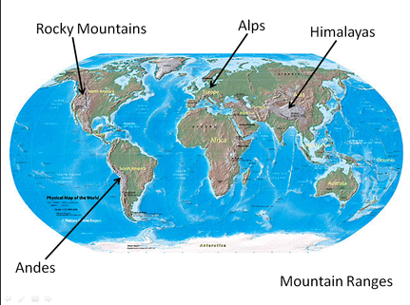
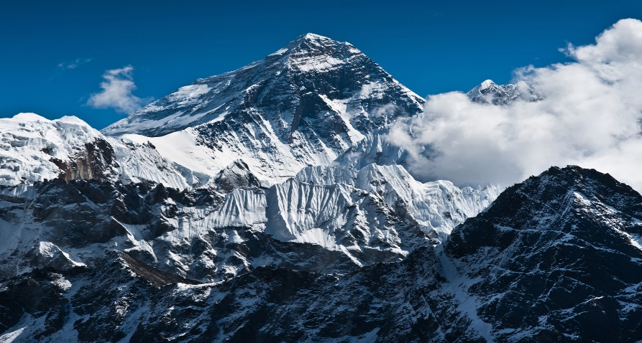
Year 4 Term 3: What makes mountains magnificent?
Key Knowledge
Vocabulary Dozen
peak | The top of a mountain
summit | The top of the mountain
topographic | The detailed mapping of a region
Contour lines | A line on a map or chart joining points of qual height or depth
dome | a rounded arch
erosion | The gradual destruction of rock by rivers, sea or weather
formed | The creation of something
steep | A very big increase or decrease
oxygen | A colourless gas
fold | A bend in the rock
Fault | A fracture in the rock where there has been movement
Fracture | A separation in a rock
Highest British peaks
Ben Nevis | Scotland
Snowdon | Wales
Scafell Pike | England
Slieve Donard | Northern Ireland
Fold Mountains
The upward fold is called an anticline
The downward fold are synclines
Zagros Mountains, The Himalayas, the Andes, Mount Blanc and the Rocky Mountains are all fold mountains.
Fault Block Mountains
They get their mountain shape by erosion over time
Formed when 2 plates move towards each other and the crust cracks along the fault lines
Sierra Nevada mountain range in California
Highest Peaks in the world
Mount Everest | Asia
Aconcagua | South America
Mount McKinley | North America
Kilimanjaro | Africa
Mount Blanc | Europe
Vinson Massif | Antarctica
Mount Kosciusko | Australia
Dome Mountains
Formed by a great amount of molten rock pushing its way up under the earths crust.
Black Hill Range and Mount Rushmore

