Slide 1
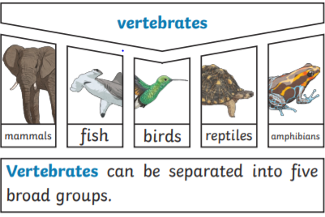
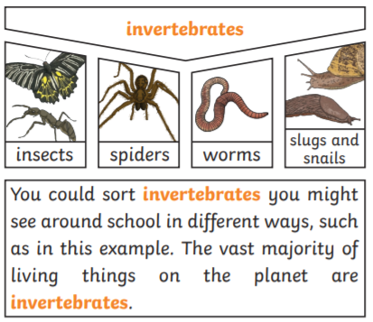
Year 4 – Living Things and their habitats
Life Processes
To stay alive and healthy, all living things need certain conditions that let them carry out the seven life processes: Movement Growth Respiration Reproduction Sensitivity Excretion Nutrition
Vocabulary Dozen
Vertebrates | Having a backbone
Invertebrates | Without a backbone
Local Environment | An environment contains many habitats and these include areas where there are both living and non-living things.
Classification | An order or group in which something is classified
habitat | The specific area or place in which particular animals or plants may live.
Endangered species | A plant or animal where there are not many of their species left and scientists are concerned that the species may become extinct.
Extinct | When a species has no more members alive on the planet, it is extinct.
Life Processes | The things living things do to stay alive.
Respiration | A process where plants and animals use oxygen gas from the air to help turn their food into energy.
sensitivity | The way living things react to changes in their environment.
reproduction | The process through which young are produced.
excretion | The process by which living things get rid of waste products.
nutrition | The process of obtaining food to provide living things with energy to live and stay healthy.
Organisms | This is another word that can be used to mean ‘living things’.
Vertebrates and Invertebrates
Environment
Changes to an environment can be natural or caused by humans. Changes to an environment can have positive as well as negative effects. Here are some examples of things that can change an environment.
NATURAL Earthquakes Storms Floods Droughts Wildfire The seasons | HUMAN MADE Deforestation Pollution Urbanisation The introduction of a new plant or animal species Creating new nature reserves

