Slide 1
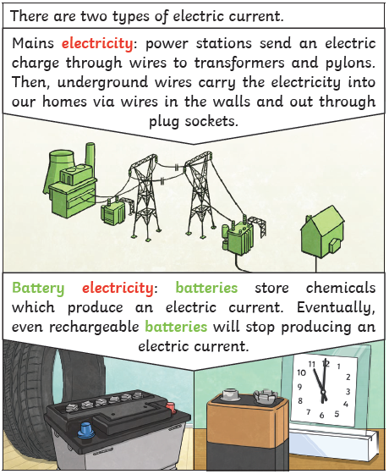
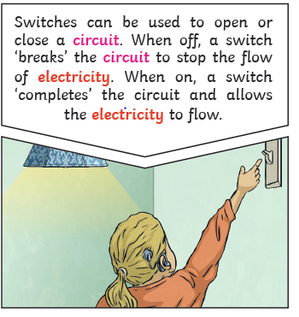
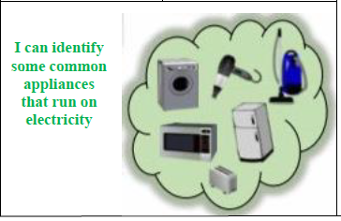
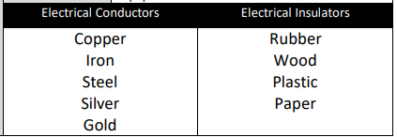
Year 4 – Electricity
Vocabulary Dozen
electricity | Energy caused by the moement of electrons through matter
Series circuit | A closed circuit in which the current follows one path
conductor | Anything that carries or allows passage of heat, electricity or sound
insulator | A material that does not conduct electricity
cell | A device that makes electricity by chemical means
switch | A device that opens and closes an electrical circuit
buzzer | An electrical device that signals by buzzing
bulb | A device made of rounded glass used to create electric light
appliance | A service used for a particular purpose e.g. stoves and fridges are home appliances.
Mains electricity | Electricity supply from power stations to households.
batteries | A device that makes electricity by using chemical reactions
Power source | It supplies electrical power to at least one electric item.

