Slide 1
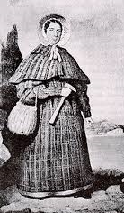
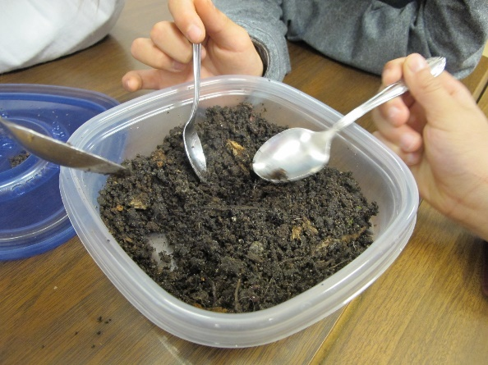
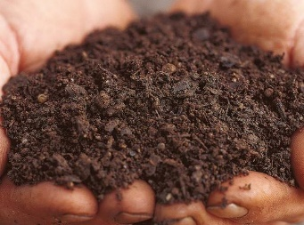
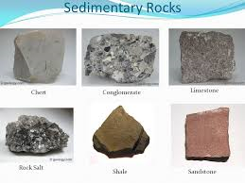
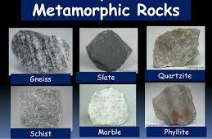
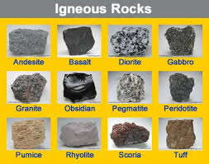
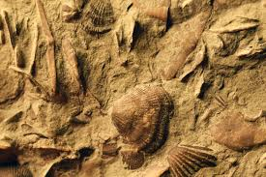
Science -Materials - Rocks
Year 3 Autumn 1
Vocabulary and meanings
fossils | The remains or impression of a prehistoric plant or animal embedded in rock and preserved in petrified form
sedimentary rock | Rock that has formed through the deposit and hardening of sediment
metamorphic rock | Rock that has changed over time under the influence of heat, pressure, or some other agent without passing through a liquid phase.
igneous rock | Rocks formed by the cooling and solidifying of molten materials
palaeontology | The study of fossils as a guide to the history of life on Earth
anthropic | Involving or concerning the existence of humans
permeable | A material allowing liquids or gases to pass through.
impermeable | A material that does not allow gases or liquids to pass through.
Timeline of
Mary Anning’s life
Born 21st May 1799 in Lyme Regis, Dorset
1811 – discovered the skeleton of a dinosaur
1823 – discovered the first Plesiosaurus skeleton
1828 – discovered the first Pterodactylus
1847 – Mary Anning died aged 47

