Slide 1
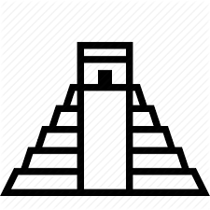
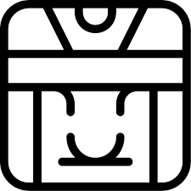
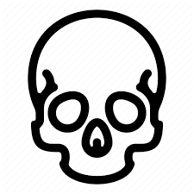
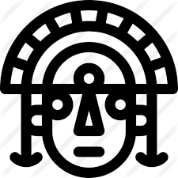
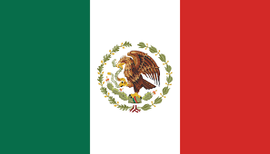
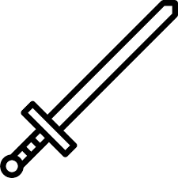
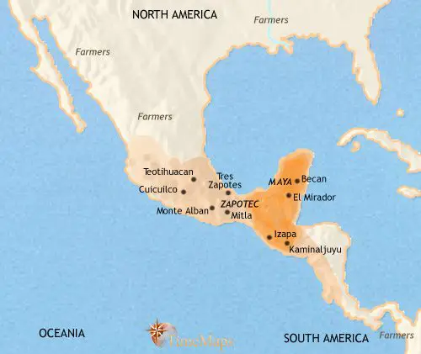
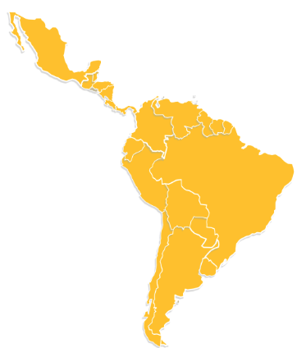
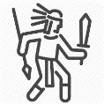
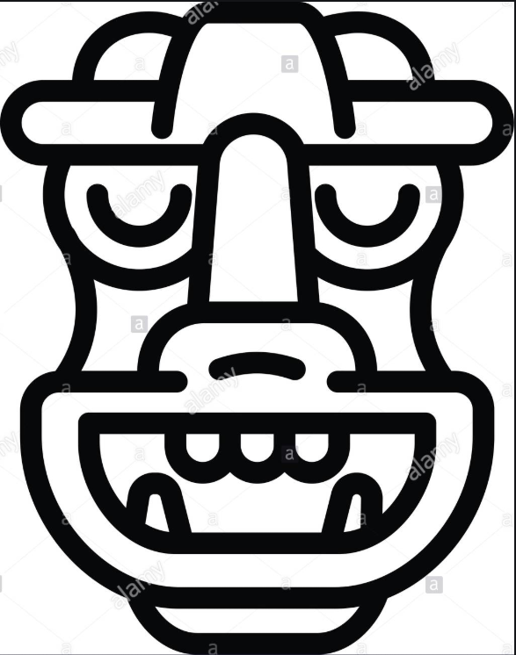
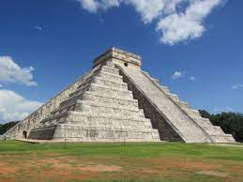
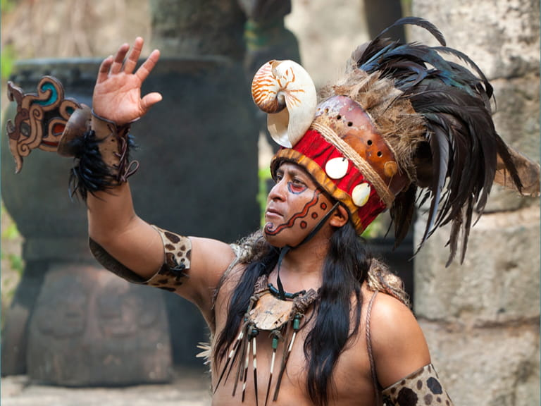
Mayan civilisation mysteriously declines
900AD
Mexico becomes independent of Spain
1821
Olmec Period
in Mesoamerica
1500-400BC
Mayan Classical Period
250BC-1000AD
Inca Period Starts
1100AD
790AD
1st Viking raids
in Britain
1066AD
Battle of Hastings
1200-1521AD
Aztec Period
City of
Chichen Itza
Pyramids
Mexico
Chronology
Belize
ruins
Existing Buildings
Guatemala
burials
Archaeologists
Interpret past
Location
Honduras
What was the lasting legacy on the Maya?
murals
Study of Art
accounts
El Salvador
carvings
South America
sculpture
diaries
City States
Maize
Spanish ships
Settlements
paintings
Bartering
Merchants & Trading
Cacao Beans
story telling
Conflicts
Beliefs
Competition for Land
Meat & Fish
Trade
rituals
Civilisation – the society and way of life of a particular area.
Territory – an area of land under the power of a ruler or state.
City State Vs
City State
Murals – a painting or work of art executed directly on a wall.
Ancestors – a person from whom one is descended from.
Temple – a building devoted to the worship of a god or gods.
Astronomy
Maya – a member of the native people of Yucatan in Central America.

