Slide 1
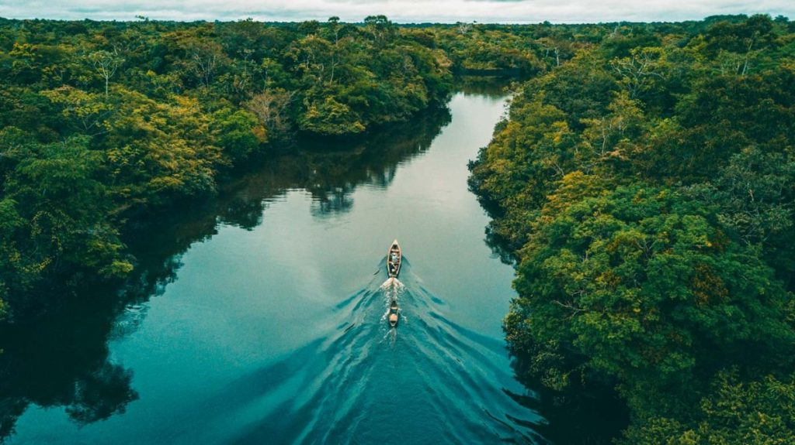

English
In English our focus will be fiction. We will be focusing on the book called Journey to the River Sea by Eva Ibbotson. From the study of this book, we will be writing a non chronological report and a narrative
We will develop our skills of using description and a range of sentence structures, as well as including our knowledge of Year 5 spelling, punctuation and grammar.
We will continue to practise the Year 5/6 words. During all lessons, we will continue to focus on a high standard of presentation, including joined handwriting.
Curriculum – Geography
This term, our curriculum focus is Geography. Our learning question is, ‘What Has South America got that the UK hasn’t?
We will learn about; the characteristics of the Amazon Basin, who and what lives there and what is deforestation.
By the end of unit, we aim to be able to construct responses in order to answer our learning question and to have a good understanding of what has South America got that the UK hasn’t.
Maths
In Year 5 this term we will continue to consolidate our previous maths learning every day using our Do Now Activities and rapid recall tests. New learning will consist of Decimals and then we move onto Negative Numbers and finish with Converting Units We will do daily times tables practise using TTRS. Please continue to support your child to practise their recall of all times tables up to 12 x 12. Your child will be working through a personal plan of times tables which they need to learn. The ability to recall these facts more confidently would be hugely beneficial.
Year 5 Newsletter
Summer Term 2025
Science
This term, we will be making learning all about Animals and Humans. Our lessons will teach us about human life cycles, why babies grow so quick, what happens when we grow and how does a humans body grow during puberty .
.
Our PE Days
Our PE morning is every Thursday. Please ensure that children have correct full outdoor and indoor PE kit in school Long hair should be tied back and earrings removed as outlined in the school’s uniform policy on our website. We would prefer them not to use plasters over earrings for health and safety reasons.
Learning Outcome
After this unit of Geography learning, children will have an understanding of South America. Through investigation and actual study of this the children can then develop their own opinion as to what South America has that the UK hasn’t.
Reading
Please continue to share the love of books with your child. Encourage them to read/share books at least 5 times per week. This should be recorded on one page per week of the Reading Record with a comment and appropriate details. Reads will be counted every Monday.
Reading should be a delightful experience and we encourage you to revisit and re-read favourite books and stories.
Happy readers become confident readers.
Wider Curriculum
Computing – Information Technology - animation
PSHE – Changing Me
Music – Singing with Mrs Gooch
PE – Tennis and Rounders
Spanish – Pets
DT – Making a bird house
Homework
Each half term the children will be set homework. This will be in the form of a homework menu. The children should choose 5 pieces to complete over the term. The children may also be set some extra Maths / English work if needed.. Please continue to learn your times tables

