Slide 1
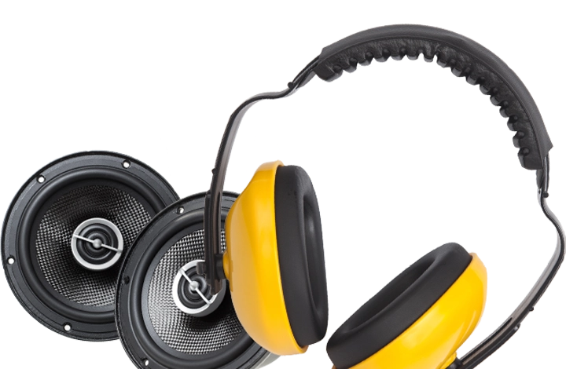
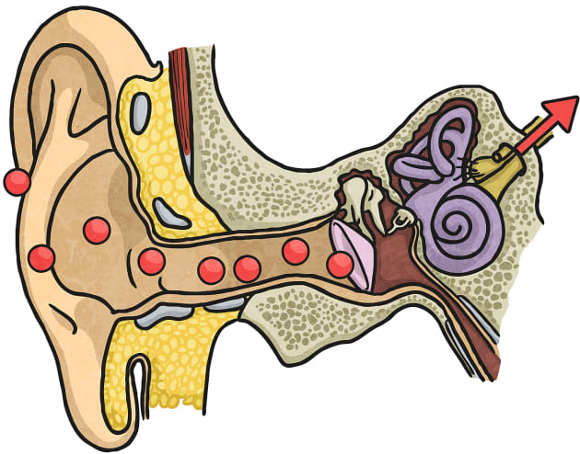
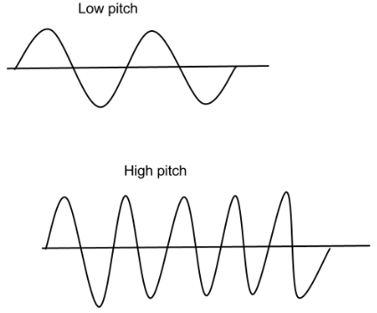
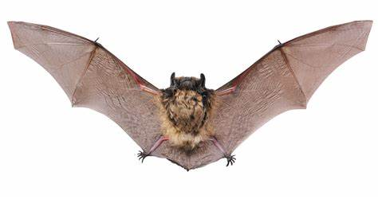
Year 4 Sound Science Knowledge Organiser
What is sound?
Every sound we hear is made by an object vibrating.
As the object vibrates, it pushes the air around it making the air vibrate too.
These vibrations, which are called sound waves, move by squeezing and stretching like a spring.
The sound travels through the air to our ears in little vibrations, which we hear as sound.
Echo: A sound that bounces back from a hard surface.
How does sound travel?
Vibrations can travel through solids and liquids as well as air. In fact, they travel faster through a solid and a liquid than air.
When there are no particles, as in a vacuum, sound cannot travel at all.
Sound travels much slower than light so an aircraft can be seen before the noise of its engines is heard. You can use this information to find out how far away a sound is.
How do we hear sound?
Ears allow us to hear sound. They respond to vibrations in the air and send nerve signals to the brain where they are interpreted as sounds.
Sounds are funnelled through the outer ear, through the ear canal to the eardrum.
Key Words
Sound Wave
Vibrations
Pitch
Volume
Echo
Vibrations
Noise Pollution
Insulate
Protecting Ears
Earmuffs block sound by absorbing the vibrations and stopping them from reaching the eardrum.
They are usually made from soft, bulky material that is good at absorbing vibrations.
Animals
Animals have evolved ears that are adapted to their environment.
Bats and dolphins use sound rather than sight to move and find their way around.
Low Pitch : Bass Guitar
High Pitch: A Whistle
Noise Pollution = Harmful or annoying levels

