Slide 1
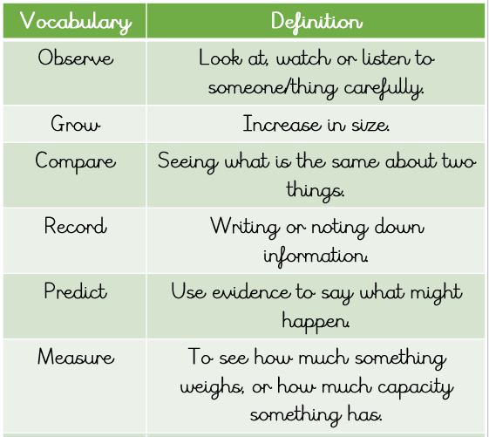
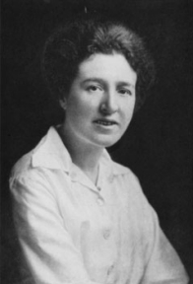
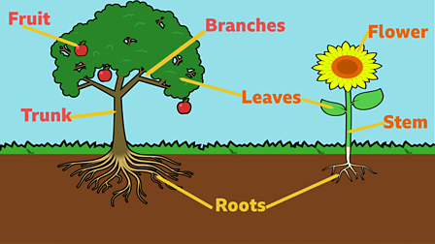
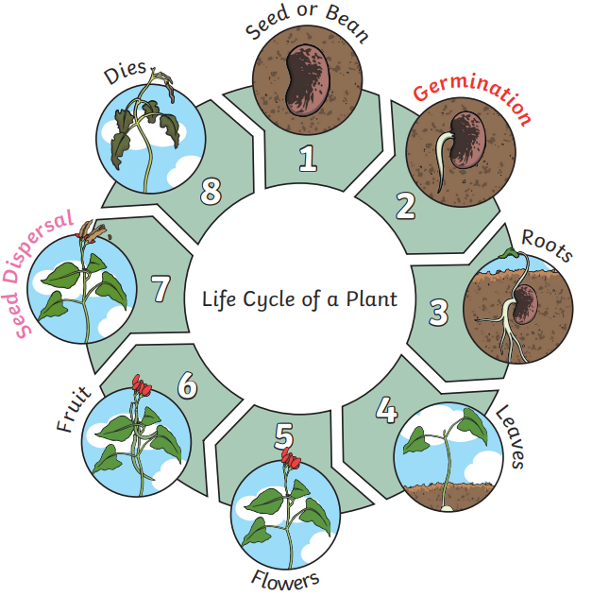
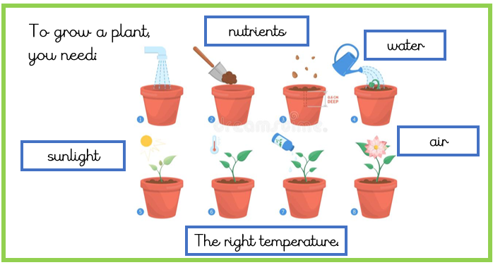
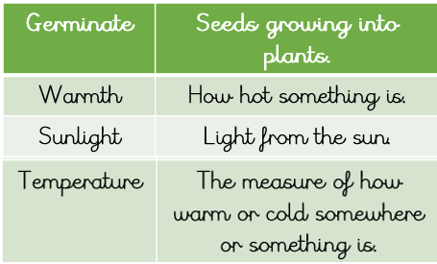
Year 2 Spring 2: Plants
Agnes Arber 1879 – 1960.
The main parts of a tree and plant.
Agnes Arber was a botanist who was the first woman to be elected as a Fellow of the Royal Society and receive the Gold Medal of the Linnean Society of London.
The germination process of a seed.

