Slide 1
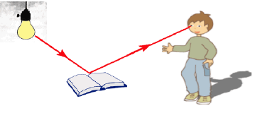
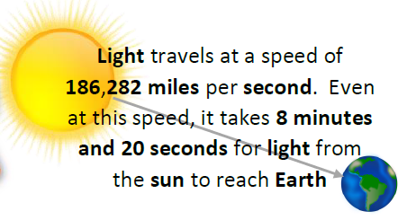
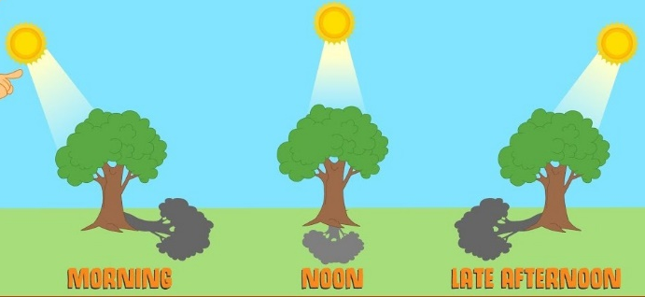
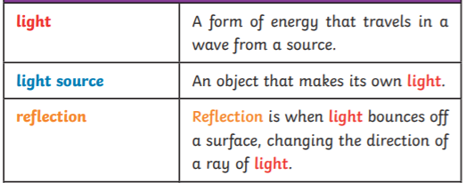
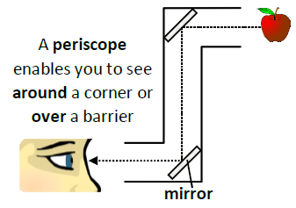
An angle is the difference in direction between two lines or surfaces. Angles are measured in degrees.
Year 6 Term 2: Light and Sight
Key Vocabulary
How does the position of the sun affect a shadow?
Shadows occur when an opaque objects blocks the sunlight.
Here are the parts of a human eye…
A periscope is a vertical tube that allows a use to see objects that are bot in the direct line of vision.

