Slide 1
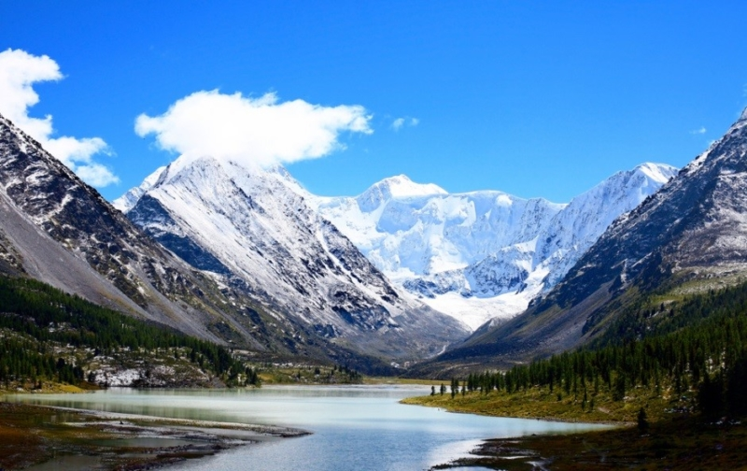
English
In English we will focus on ‘The Iron Man’ by Ted Hughes.
We will explore fiction writing, including a recount of the story.
We will continue to develop our sentence skills of using compound and complex sentences.
We will also look at the features of newspaper reports before writing our own linked to The Iron Man.
We will also include our knowledge of Year 4 spelling, grammar and punctuation. We will continue to use Year 3/4 words in all of our writing.
During all lessons, we will continue to focus on a high standard of presentation, including joined handwriting.
Curriculum – Geography
This half term in Year 4, our Geography enquiry question will be: “What makes mountains magnificent?” Our learning will involve describing and understanding key aspects of physical geography, including mountains. We will be exploring what mountains actually are as well as the different types of mountain. We will also learn how the mountain ranges of the world were formed and begin to understand the composition of the earth: crust, mantle and core.
Maths
In Year 4 this term we will continue to consolidate our previous maths learning every week using our Do Now Activities. We will continue our learning of multiplication and division, as well as length and perimeter. Timed, weekly arithmetic tests will also be set. Please continue to support your child to practise their recall of all times tables up to 12 x 12. We will be using TT Rockstars to aid this. Your child will be working through a personal plan of times tables which they need to learn. The ability to recall these facts more confidently would be hugely beneficial for your child in their Maths lessons.
Year 4 Newsletter
Spring 1 2024
Science
This term Year 4 will learn about Electricity. We will be looking how different things are powered – mains or battery. We will also be looking at how electricity can be dangerous and how we can keep ourselves safe.
We will also be making electric circuits and then seeing which materials conduct electricity.
Our PE Days
Our PE morning is every Friday. Please ensure that children have correct indoor PE kit as well as their swimming kit in school. Long hair should be tied back and earrings removed as outlined in the school’s uniform policy on our website.
Learning Outcome
After this unit of Geography learning, children will produce a fact sheet all about Mount Everest. The children will choose how to present their work either using a computer / Ipad or writing it.
Reading
Please continue to share the love of books with your child. Encourage them to read/share books at least 5 times per week. This should be recorded in the Reading Record with a comment and appropriate details. Reads will be counted every Monday.
Reading should be a delightful experience and we encourage you to revisit and re-read favourite books and stories.
Happy readers become confident readers.
Wider Curriculum
ICT – Digital Literacy
PSHE – Dreams and Goals
Music – Stop! – composing songs with meaning
PE – Swimming
Spanish – Fruit
Homework
Each week the children will be set homework on a Friday to be submitted by following Thursday, a short piece of Geography recall work to be submitted in their homework books.
Times tables will also be set on a Friday ready for the following Friday.The children may also be set some extra Maths / English work if needed.

