Slide 1
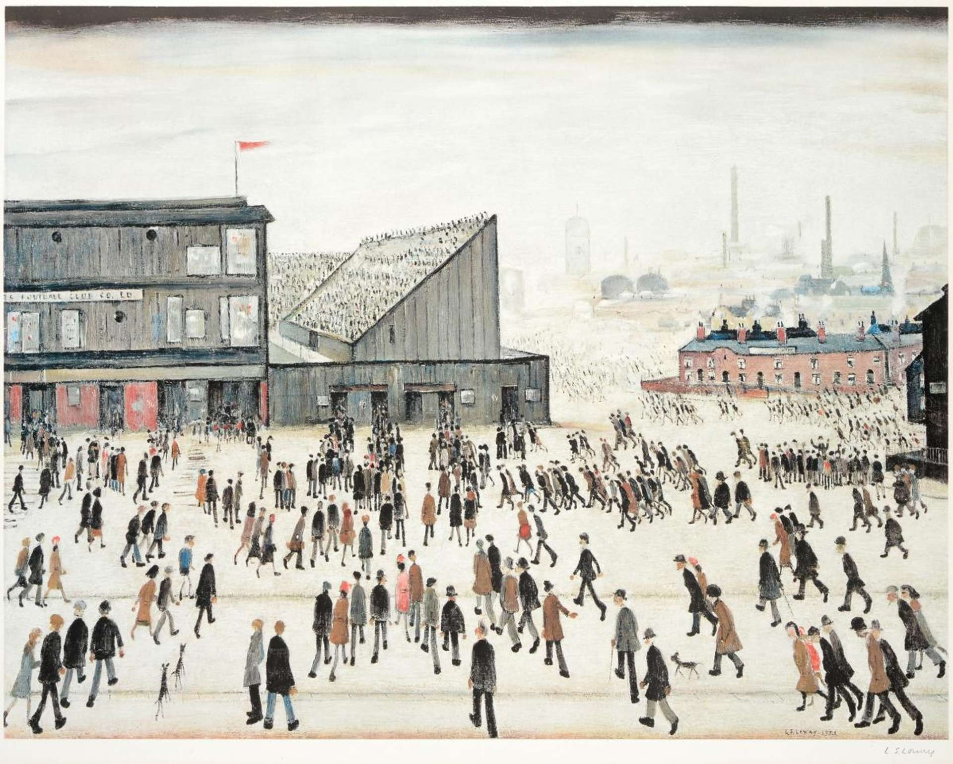
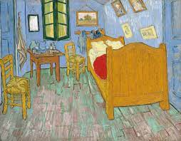
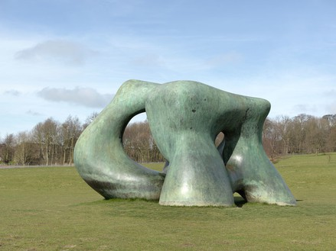
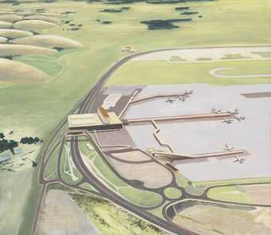
Literacy
We will develop our writing by learning about the text Shackleton’s journey, which will explore the journey of Ernest Shackleton and his crew as they set sail on expedition to Antarctica. We will be writing a biography of one of the crew members alongside a narrative on the crew’s journey.
Curriculum – Art
This term, our curriculum focus is Art. Our learning question is, ‘How do Artists use perspective?”
We will be studying various artists such as; Van Gogh, LS Lowry and local artists to build our understanding of realism and impressionism. We will be learning and practicing drawing and shading skills daily, which will allow us to create a final piece of learning.
Maths
This term, we will be learning about division and continue developing our understanding of fractions. Furthermore, we will continue will our daily implementation of quick maths and our D.N.As to recall on previous learning and to develop our fluency and problem-solving skills.
Science
This term, we will be learning and making investigations into properties of materials by comparing materials across different states. We will learn about reversible and irreversible changes, mixing and separating materials and revisit our knowledge of solids, liquids and gases.
Heather Class
Spring Term 2 Newsletter
Wider Curriculum
Jigsaw – Healthy me
Computing – Coding – creating a game.
Music – Singing with Mrs Gooch and Glockenspiel with Mr Carlton
PE – Hockey and Gymnastics - Flight
Spellings – Continue developing a range of approaches to spelling.
PE is on a Tuesday afternoon – please ensure full kit is always in school and our uniform policy is adhered to for health and safety. Our school P.E kit consists of a Middlethorpe sport polo or white t-shirt and black shorts and sport trainers.
Homework
Children will be assigned homework on a Friday, which will be due in the following Thursday. Children will be given homework books. The same expectations apply with presentation, when completing any homework projects.
Homework will entail research, quizzes and recapping previous learning alongside self-discovery around our curriculum topic of Art.
Children may be given additional homework in relation to Literacy and Maths but this will be given at teacher discretion.
If you have any issues with your child returning homework or struggling with homework, please contact Mr Cadman ASAP.
Reading
Please continue to support your child to continue a love of reading. Reading records should be filled in 5 times per week and returned to school every Friday. In our class, we have a reading fluency challenge, where you time yourself for a 1 minute and see how many words you can read. You are aiming for 90-100 words. If you read many more, try a more challenging book to read. Most importantly, enjoy your reading time.

