Slide 1
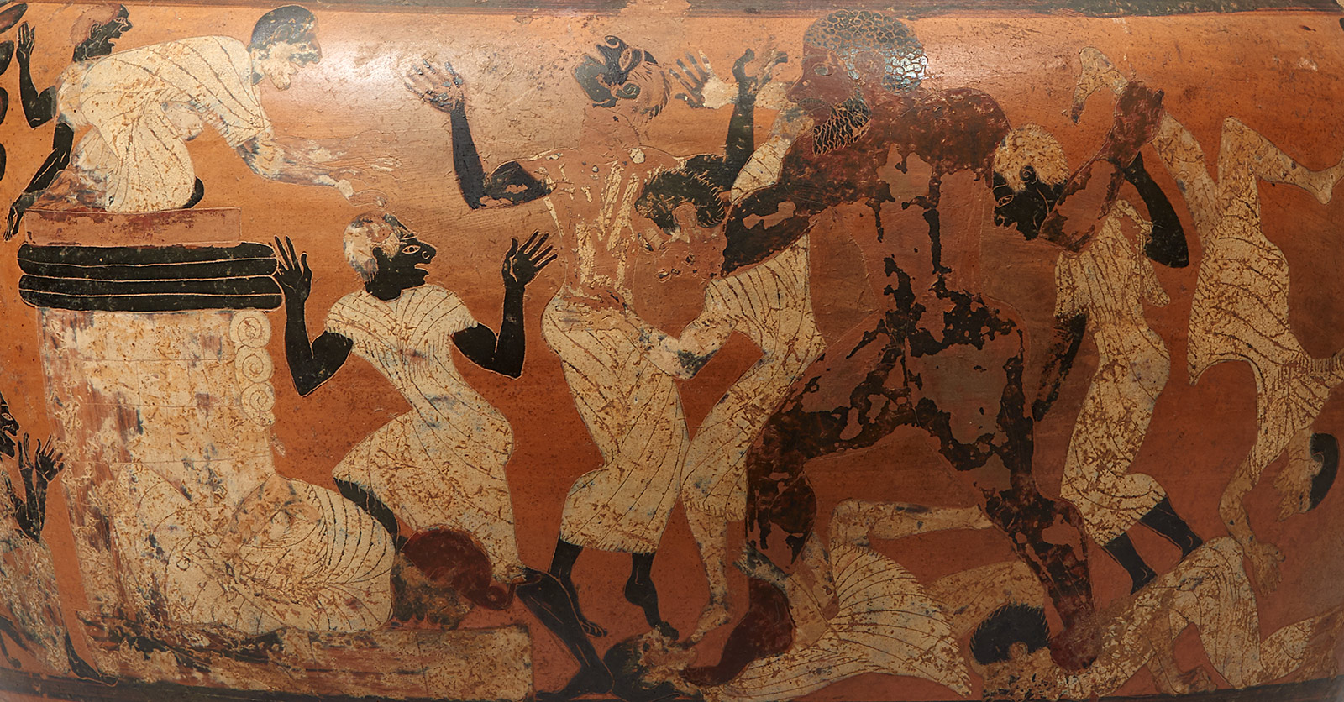

English
In English our focus will be fiction. We will be focusing on the book called ‘The Wild Robot’ by Peter Brown, From the study of this book, we will be creating descriptive pieces about characters and settings, as well as writing a persuasive speech. We will develop our skills of using description and a range of sentence structures, as well as including our knowledge of Year 4 spelling, punctuation and grammar.
We will continue to practise the Year 3/4 words. During all lessons, we will continue to focus on a high standard of presentation, including joined handwriting.
Curriculum – History
This half term in Year 4, our History enquiry question will be: “How far did the Ancient Greeks influence the Western World?”
Our learning will involve placing events on a timeline–relating back to prior knowledge. We will learn what it was like in Ancient Greece and who ruled. We will also begin to understand what was important to the Greeks and their beliefs. Finally, we will research and study the reasons that we remember the Greeks today.
Maths
In Year 4 this term we will continue to consolidate our previous maths learning every day. New learning will consist of decimals, money and time. In preparation for the Multiplication Tables Check in June, we will do daily practise using Timestables.co.uk, as well as TTRS. Please continue to support your child to practise their recall of all times tables up to 12 x 12. The ability to recall these facts more confidently would be hugely beneficial.
Year 4 Newsletter
Summer 1 2025
Science
This half term Year 4 will be learning about Living things and their Habitats. We will learn about the seven different life processes as well as about the different environments they live in. We will also learn how to classify animals.
Our PE Days
Our PE morning is every Wednesday. Please ensure that children have correct full outdoor and indoor PE kit in school Long hair should be tied back and earrings removed as outlined in the school’s uniform policy. We would prefer them not to use plasters over earrings for health and safety reasons.
Learning Outcome
After this unit of History learning, children will have an understanding of the influence that Ancient Greeks have on modern life. They will be able to identify the lasting achievements of Ancient Greek culture that can still be seen in Britain today.
Reading
Please continue to share the love of books with your child. Encourage them to read/share books at least 5 times per week. This should be recorded on one page per week of the Reading Record with a comment and appropriate details. Reads will be counted every Monday.
Reading should be a delightful experience, and we encourage you to revisit and re-read favourite books and stories.
Happy readers become confident readers.
Wider Curriculum
ICT- Digital Literacy (E-Safety)
PSHE – Relationships
Music – Singing
PE – Outdoor Athletics & Cricket
Homework
Each week the children are asked to return their homework books on a Monday.
Times tables will also be set on a Friday ready for the following Friday.

