Slide 1
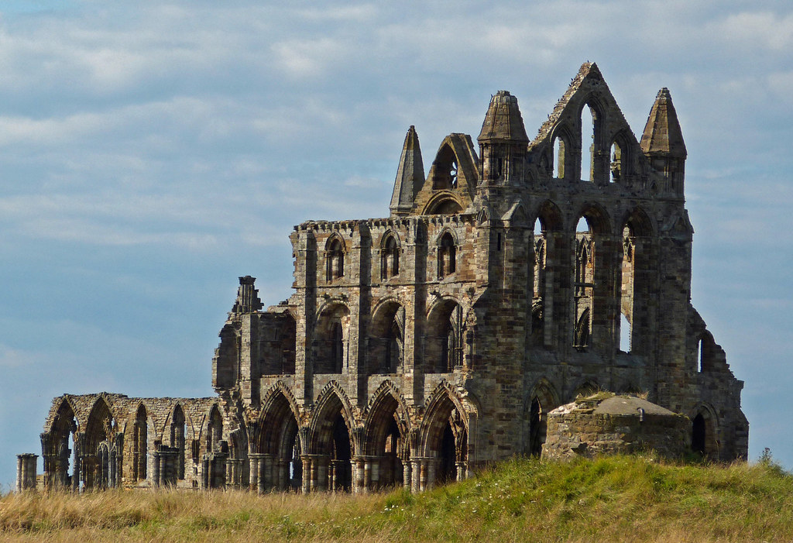
English
In English our focus will be fiction. We will be focusing on the book called ‘Oliver and the Seawigs’ by Philip Reeve., From the study of this book, we will be creating descriptive pieces about a setting as well as writing a biography about a famous explorer. We will develop our skills of using description and a range of sentence structures, as well as including our knowledge of Year 4 spelling, punctuation and grammar.
We will continue to practise the Year 3/4 words. During all lessons, we will continue to focus on a high standard of presentation, including joined handwriting.
Curriculum – Geography
This half term in Year 4, our Geography enquiry question will be: “What makes Whitby wonderful?”
Our learning will involve finding out where Whitby is–relating this to prior learning. We will learn what it is like in Whitby compared to Cleethorpes. We will also look at the area surrounding Whitby. A lot of the fieldwork will be carried out on our visit to Whitby.. Finally, we will research and study the reasons why Whitby is wonderful.
Maths
In Year 4 this term we will continue to consolidate our previous maths learning every day. New learning will consist of statistics and position and direction. In preparation for the Multiplication Tables Check in June, we will do daily practise using Timestables.co.uk, as well as TTRS. Please continue to support your child to practise their recall of all times tables up to 12 x 12. The ability to recall these facts more confidently would be hugely beneficial.
Year 4 Newsletter
Summer 2 2025
Science
This half term Year 4 will be learning about Sound. We will learn about how sounds make it to our ears, how we can classify different sounds, what sounds we can hear, and we will be making a string telephone and seeing how it works
Our PE Days
Our PE morning is every Wednesday. Please ensure that children have correct full outdoor and indoor PE kit in school Long hair should be tied back and earrings removed as outlined in the school’s uniform policy on our website. We would prefer them not to use plasters over earrings for health and safety reasons.
Learning Outcome
After this unit of Geography learning, children will have an understanding of what Whitby is like and how it compares to Cleethorpes. Through investigation and actual study of the area, the children can decide if Whitby is wonderful.
Reading
Please continue to share the love of books with your child. Encourage them to read/share books at least 5 times per week. This should be recorded on one page per week of the Reading Record with a comment and appropriate details. Reads will be counted every Monday.
Reading should be a delightful experience, and we encourage you to revisit and re-read favourite books and stories.
Happy readers become confident readers.
Wider Curriculum
ICT – Information Technology
PSHE – Changing Me
Music – Recorders
PE – Cricket & Tennis
DT – How can we create a healthy food item?
Homework
Each week the children are asked to return their homework books on a Monday.
Times tables will also be set on a Friday ready for the following Friday.

