Slide 1
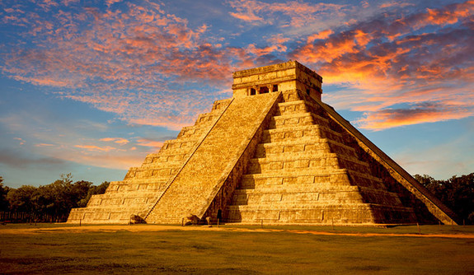
Literacy
We will develop our writing by learning about the text – Cosmic by Frank Cottrell-Boyce , which will explore the journey of Liam , who makes a giant leap for boy-kind by competing with a group of adults for the chance to go into space. We will write a persuasive advert and a narrative.
Curriculum – History
This term, our curriculum focus is History. Our learning question is, ‘What is the lasting legacy of the Mayans?’
We will learn about; what the Mayan world was life, why was trade so important for them, what were they good at and what happened to the Maya.
By the end of unit, we will be able to construct a timeline of events, understand how their life changed overtime and describe their cultural and religious beliefs.
Maths
This term, we will be learning about continue developing our understanding of decimals, fractions and percentages alongside learning about area and perimeter. Furthermore, we will continue with our daily implementation of quick maths and our D.N.As in order to recall on previous learning and to develop our fluency and problem solving skills.
Science
This term, we will be making learning all about living things and their habitats. Our lessons will teach us about plants and their parts. How mammals and plants reproduce and how to classify different mammals due to their features.
Heather Class
Summer Term 1 Newsletter
Wider Curriculum
Jigsaw – Relationships
Computing – Information technology - animation
Music – Glockenspiel with Mr Carlton
PE – Athletics and Rounders
Spellings – Continue developing a range of approaches to spelling.
PE is on a Tuesday afternoon – please ensure full kit is in school at all times and our uniform policy is adhered to for health and safety. Our school P.E kit consists of a Middlethorpe sport polo or white t-shirt and black shorts and sport trainers.
Homework
Children will be assigned homework on a Friday, which will be due in the following Thursday. Children will be given homework books. The same expectations apply with presentation, when completing any homework projects.
Homework will entail research, quizzes and recapping previous learning alongside self-discovery around our curriculum topic of History.
Children may be given additional homework in relation to Literacy and Maths but this will be given at teacher discretion.
If you have any issues with your child returning homework or struggling with homework, please contact Mr Cadman ASAP.
Reading
Please continue to support your child to continue a love of reading. Reading records should be filled in 5 times per week and returned to school every Friday. In our class, we have a reading fluency challenge, where you time yourself for a 1 minute and see how many words you can read. You are aiming for 90-100 words. If you read many more, try a more challenging book to read. Most importantly, enjoy your reading time.

