Slide 1
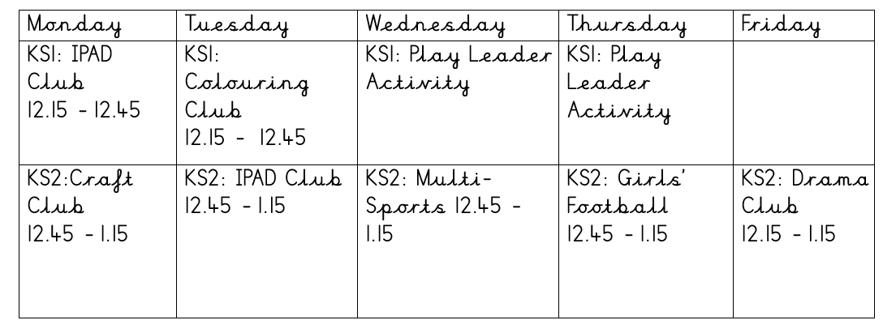
PE Enrichment @MIDDLETHORPE
At Middlethorpe Primary Academy, we believe that it is vital for all our pupils to learn from and about leading a physical and healthy lifestyle, so that they can understand how to manage/improve their life. Alongside our curriculum, we offer a range of clubs, which allow pupils to access a variety of opportunities to develop their skills and to complete activities at their leisure.
Extra – Curricular Club Timetable – Summer Term 2
Experiencing
Competition
Throughout the year, we offer all pupils in Key Stage 2 the chance to compete and participate in competition. We value this as an important factor in developing the skills learnt in school in order to use them in a competitive environment.
School Games Award 2021/2022
We are proud to have achieved the ‘Gold’ School Games award for 2021/2022.
After School Club Timetable – Summer Term 2
Daily implementation:
Daily Mile
Playground leaders
Enrichment Clubs
Club/School Links:
Grimsby Town Football Club
Cleethorpes Academy
Caistor Yarborough
Oasis Academy Wintringham – School Sport Partnership
Trin

