Slide 1
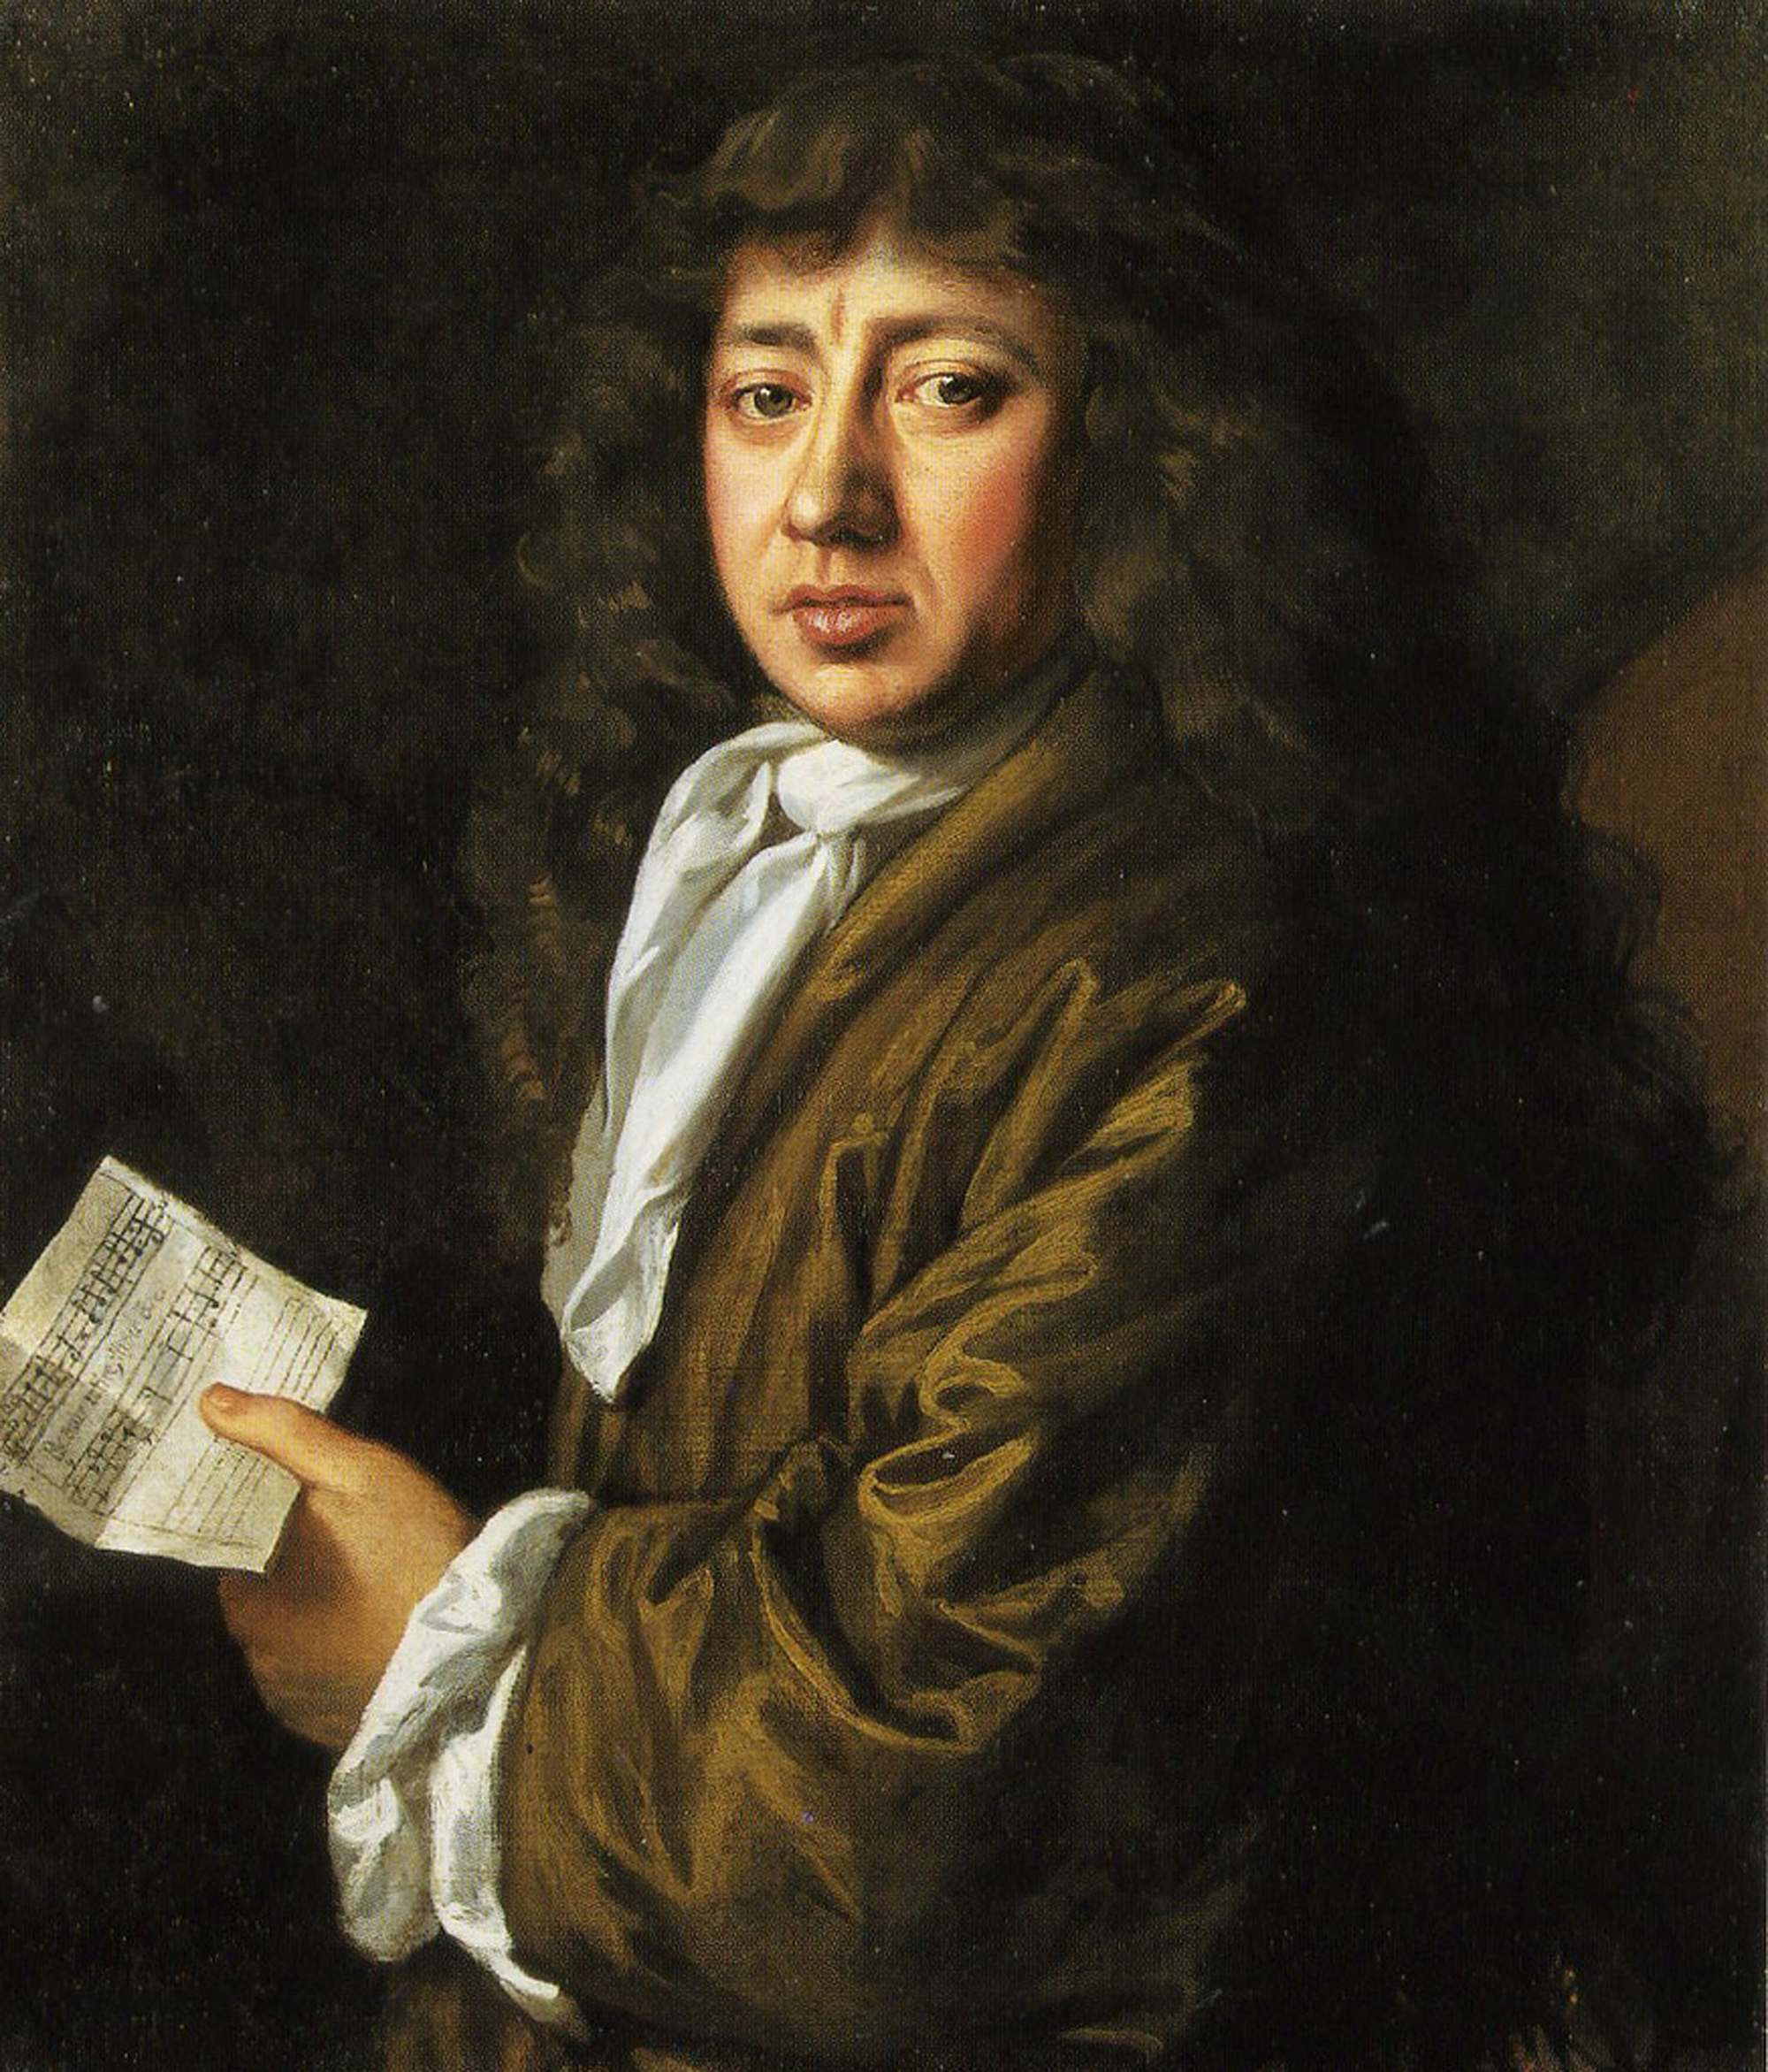
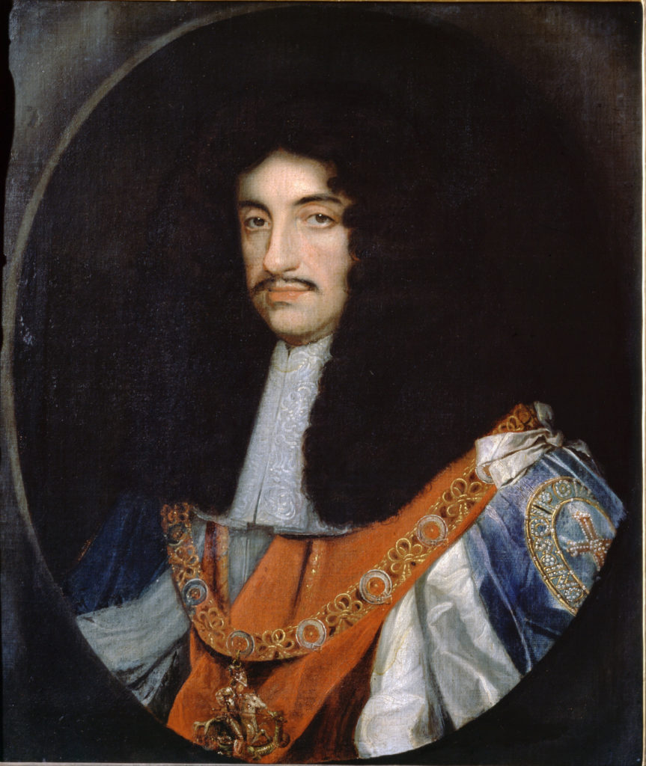
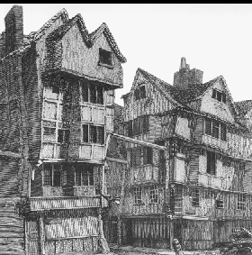
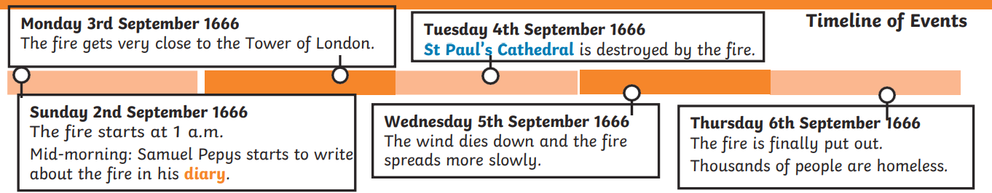
The Great Fire of London
Year 2 Summer 1
King Charles 11
The king of England at the time of the Great Fire.
Key Events and Facts.
The fire started on Sunday 2nd September 1666 in Thomas Farriner’s bakery on Pudding Lane.
The fires used for baking were not put out properly.
In 1666 the buildings of London were made out of wood and straw and were very close together, making it easy for the flames to spread.
It had been a dry summer, so the buildings were dry and the winds were blowing.
Vocabulary | Definition
London | Capital city of England.
Diary | A book to record personal events or experiences.
Flammable | Easily set on fire.
Eyewitness | A person who has seen something happen.
Bakery | A place where bread and cakes are sold.
Pitch | pitch is a tar like substance that protects wood from water damage.
Embers | A small piece of burning coal or wood in a dying fire.
Monument | A statue or building put to show respect for a person.
Burn | Produce flames and heat.
Buildings | A structure with a roof and walls.
Samuel Pepys
1633 – 1703
Samuel Pepys lived over 300 Years ago, when the Fire of London occurred.
He wrote a diary recording all the events of the Great Fire.
S
M
T
W
Th
F
The houses in London in 1666 before the Great Fire of London occurred.

