Slide 1
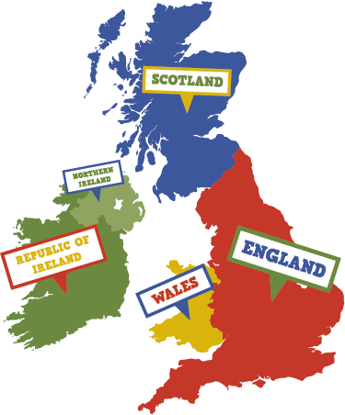
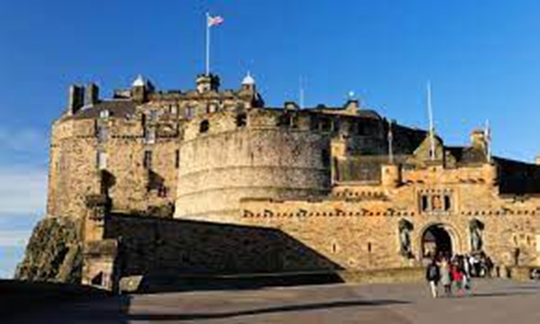
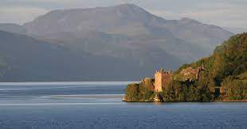
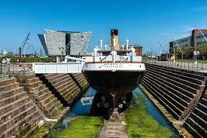
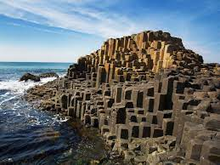
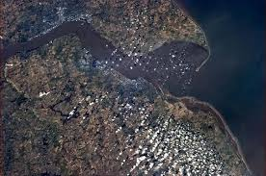
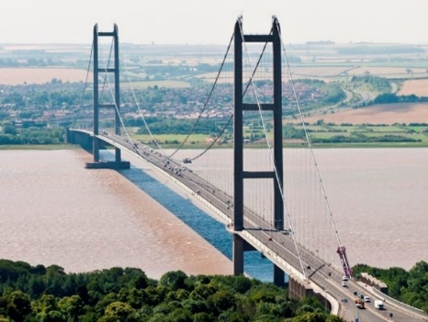
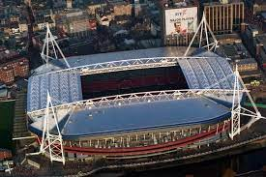
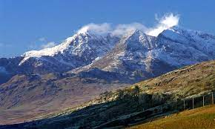
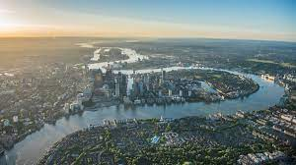
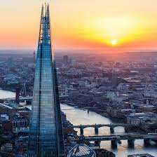
What are the ‘WONDERS’ of the United Kingdom?
Ancient volcanic eruption
Titanic Belfast Museum
Giant’s
causeway
Edinburgh Castle
Loch Ness
Lake in the Highlands
Scotland - Edinburgh
Northern Ireland - Belfast
Longest in UK
Humber Bridge
Highest mountain in Wales
1981
Millennium Stadium
Mount
Snowdon
River Humber
suspension
River Thames
The Shard
Tallest building in UK
Wales - Cardiff
Year 2 Term 3 @MPA
England - London
north | The top area of a map or compass
south | The bottom area of a map or compass
landmark | An important building or features
Thames | A river in London
stadium | A large sports ground
purpose | The reason why something is done
causeway | A raised path or road that crosses water
environment | Your natural surroundings

