Slide 1
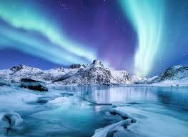
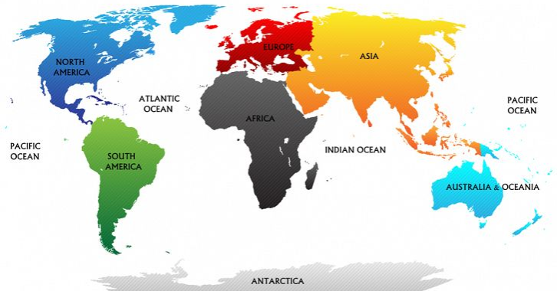
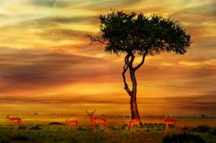
The World
Continents | Oceans
Asia | Arctic
Africa | Atlantic
North America | Indian
South America | Pacific
Antarctica | Southern
Europe
Australia
The region close to the equator is hot
The regions close to the north and south poles are cold
There are several countries in each continent
The UK is on the continent of Europe
Different parts of the world have different physical features
Vocabulary
Climate | The weather in a place over time
Biome | A biome is a large area characterized by its vegetation, soil, climate, and wildlife.
Continent | One of the worlds large areas of land
Equator | An imaginary line around the middle of the Earth that divides the Northern and Southern Hemispheres
Aquatic | Covers most of the Earth and are rivers, lakes, oceans and seas
Desert | An area with very low rainfall and can be very hot or very cold
Forest | A place where there are lots of trees
Grassland | A large area of grasses, flowers and plants
Savannah | Tropical grassland with a warm temperature all year round
Rainforest | Forest with tall trees, warm climate and lots of rain
tundra | A large, cold, tree less area where the soil is frozen
Biomes
Aquatic
Desert
Forest
Grassland
Savannah
Rainforest
tundra

