Slide 1
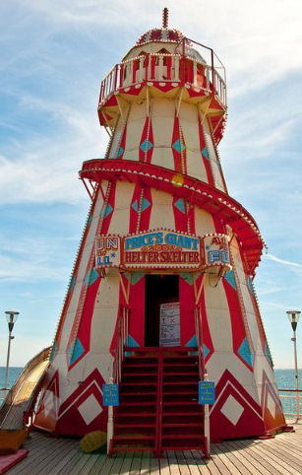
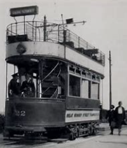
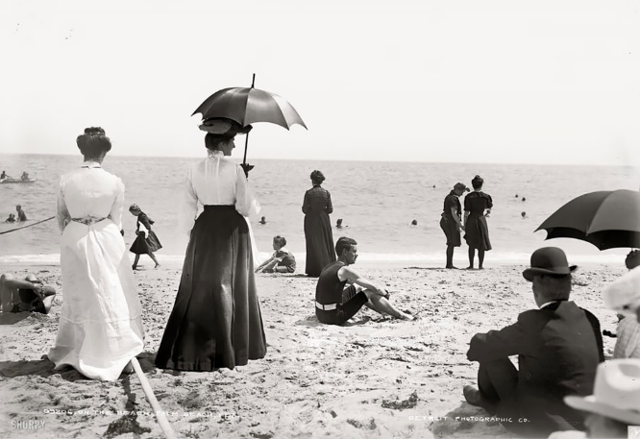
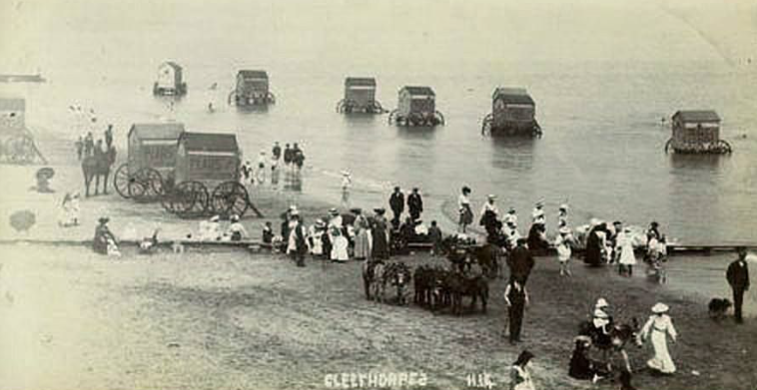
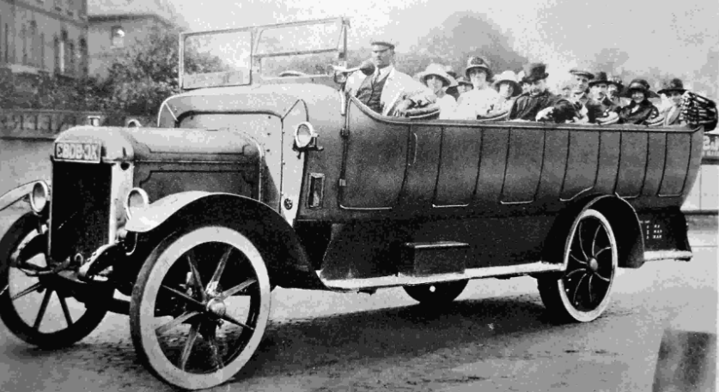
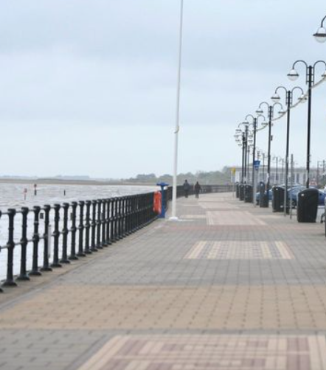
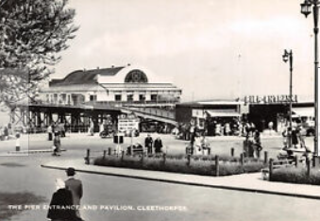
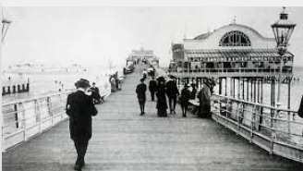
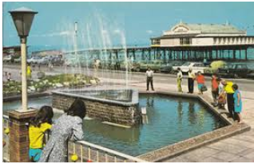
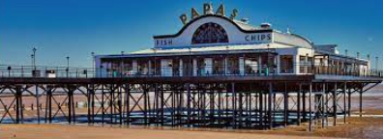
Year 1 Summer 1: History
How have holidays at Cleethorpes changed?
Helter-skelter
A fairground amusement with a spiral slide winding around a tower
In Victorian times, people would travel to the seaside to enjoy activities, such as a puppet show, walk along the promenade or to go sea bathing.
Victorians
People who lived when Queen Victoria ruled (from 1837-1901)
Tourist
Someone who travels or visits a place for pleasure
Concert hall
A large public building used for the performance of concerts
Tram
A passenger vehicle powered by overhead electric cables
The Victorians believed that sea air was good for you and that sea bathing would make you healthy.
Charabancs
An early form of bus, used for pleasure trips
Resort
A popular place for holidays
Sea bathe Swimming in the sea
Pavilion
A decorative building used as a shelter in a park or large garden
Pier
A structure built out into the water for people to walk on
Pier and Pavilion 1955
Pier and fountains
1970s
Pier and Pavilion 1900
Pier and Pavilion
2020
Promenade
A public place for walking for pleasure

