Slide 1
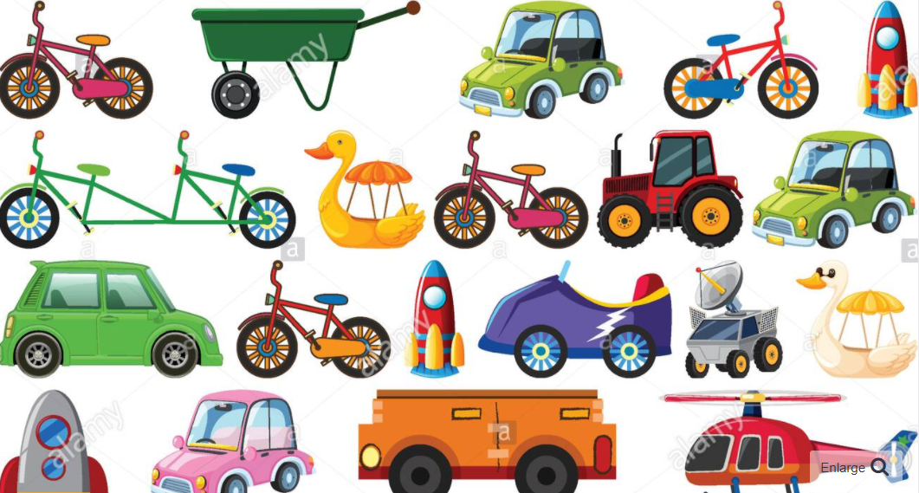
English
Our text this half term will be ‘The Robot and the Bluebird’. We will use this beautiful story to think about the world around us and appreciate the changing seasons. It also carries on our theme of friendship within stories.
We will continue to develop our phonics skills through Little Wandle, which includes whole class phonic sessions, small group work and guided reading sessions in Year 1.
Handwriting will remain a focus for us this term and we will work on improving our gross and fine motor skills, using regular movement and routines. We will work hard to form pre-cursive letters correctly, using Letter-join resources, both paper and computer based.
Curriculum – R.E.
This half term, our R.E. focus enquiry question will be, ‘Are all celebrations the same?’
We shall learn about some of the events celebrated in Judaism i.e. Shabbat and Chanukah, and in Christianity i.e. the Creation Story and Christmas. We will also learn about the different beliefs which underpin these celebrations. We will then use our knowledge of these celebrations to decide whether all celebrations are the same.
Maths
In Year 1 this term we will apply our understanding of place value to addition and subtraction. We will consider part-whole models and bar models to support our thinking and knowledge around the components of a number sentence. We will use this knowledge in a variety of situations including measures, time and money. Encouraging your child to have a go at this practically and explain their thinking and reasoning will develop their confidence and be hugely beneficial within their Maths lessons.
We are also focusing on spotting reversals in our numerals.
Bluebell Class
Newsletter
Autumn 2 2023
Miss Whittaker and Mrs Fenwick
Science
This half term, Year 1 will learn about ‘Animals Including Humans’. We will learn about body parts, our senses and look into a range of different animals and how to categorise them looking at similarities and differences and finally the three types of animals.
We will also be learning about the change of season from autumn to winter.
Reading
Please continue to share the love of books with your child. Reading has such a positive impact on our children’s writing and spelling.
Your child’s Little Wandle e-book should be read 5 times per week to improve their fluency and recognition of words. We encourage the children to read and re-read books that contain sounds that they know.
In addition to this, please encourage your child to share online or real books. Any reading/sharing of books should be recorded on their Reading Record, one entry per day, and brought into school every Thursday. Certificates are given for 25 reads, then 50, 75 and 100 reads.
Learning Outcome
At the end of this term we will create a quiz, to challenge the children in Year 1.
Wider Curriculum
Computing – Algorithms
PHSE – Celebrating Difference
Music – Singing with Mrs Gooch
PE – Indoor Athletics and Object Control
DT – Mechanisms and Design a moving vehicle.
P.E.
Year 1 will have PE every Thursday Morning. Please ensure that children bring a full outdoor and indoor PE kit. As often as weather allows PE will be outside. Children will be expected to come to school in their normal school uniform and we will teach them how to get changed for their lessons.
Long hair should be tied back and earrings removed where possible otherwise please provide plasters.
Please remember to label all the children’s uniform, this really helps us to identify mislaid items.
Homework
Every Friday the children will be set one piece of homework linked to their R.E. or Science Knowledge Organisers. This should be returned by the following Thursday. Some creative homework will occasionally be included. Remember that any additional learning your child completes will be welcomed and celebrated.

