Slide 1
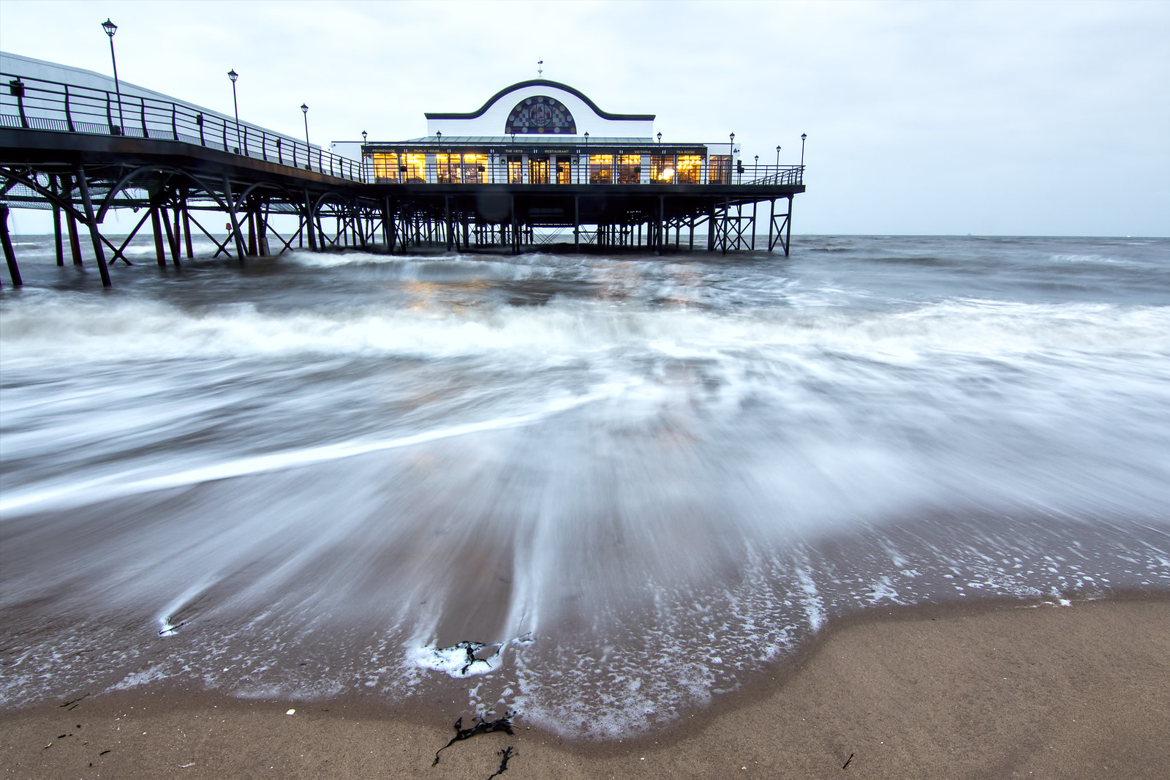
English
Our text this half term is an adventure story titled ‘The Last Wolf’ and is written by Mini Grey. The author has re-imagined the classic Little Red Riding Hood fable in an entirely new way. The text links with our geography focus on animals and their habitats and has the themes of environment and conservation.
We will continue to develop our phonics skills through Little Wandle, which includes whole class phonic sessions, small group work and guided reading sessions in Year 1.
Handwriting is a key focus for us this term and we will work on improving the formation of pre-cursive letters, using Letter-join resources.
Curriculum – Geography
This half term, our geography focus enquiry question is ‘Why do different animals live in different parts of the world?’ We will learn about the main biomes and find out why certain areas and climates suit some animals but not others. We will be able to name and locate the seven continents and five oceans of the world. then finally use our knowledge and geographical skills to be able to explain why and how humans, animals and plants live in each biome.
Maths
In Year 1 this term we will extend our understanding of place value to 20 and apply it in addition and subtraction calculations. We will be looking at Position and Direction and learning about turns and left and right. We will use this knowledge in a variety of situations including time and money. Encouraging your child to have a go at this practically and explain their thinking and reasoning will develop their confidence and be hugely beneficial within their Maths lessons. We are continuing to focus on spotting reversals in our numerals.
Bluebell Class
Newsletter
Summer 2 2025
Mrs Holt and Miss Day
Reading
Please continue to share the love of books with your child. Reading has such a positive impact on our children’s writing and spelling.
Your child’s Little Wandle e-book should be read 5 times per week to improve their fluency and recognition of words. We encourage the children to read and re-read books that contain sounds that they know. A library book of your child’s choice will be brought home to share too.
As always, please encourage your child to share online or real books. Any reading/sharing of the Little Wandle books should be recorded on their Reading Record, one entry per day, and brought into school every Thursday. Certificates are given for every 50 reads, up to 300!
Science
This half term, Year 1 will revisit the topic of Everyday Materials. We will continue to investigate different materials and their uses through the use of experiments.
Learning Outcome
At the end of this term we will create a quiz, to challenge the children in Year 1.
Wider Curriculum
Computing – Information Technology - making videos
PHSE – Relationships
Music – glokenspiels
PE – Locomotion 1 and Rounders
DT – Make a smoothie
P.E.
Year 1 will have PE every Friday morning. Please ensure that children bring a full outdoor and indoor PE kit. As often as weather allows PE will be outside. Children will be expected to come to school in their normal school uniform and we will teach them how to get changed for their lessons. Long hair should be tied back and earrings removed where possible otherwise please provide plasters. Please remember to label all the children’s uniform, this really helps us to identify mislaid items.
Homework
Every Friday the children will be set one piece of homework linked to their Geography or Science Knowledge Organisers. This should be returned by the following Thursday. Some creative homework will occasionally be included. Remember that any additional learning your child completes will be welcomed and celebrated.

