Slide 1
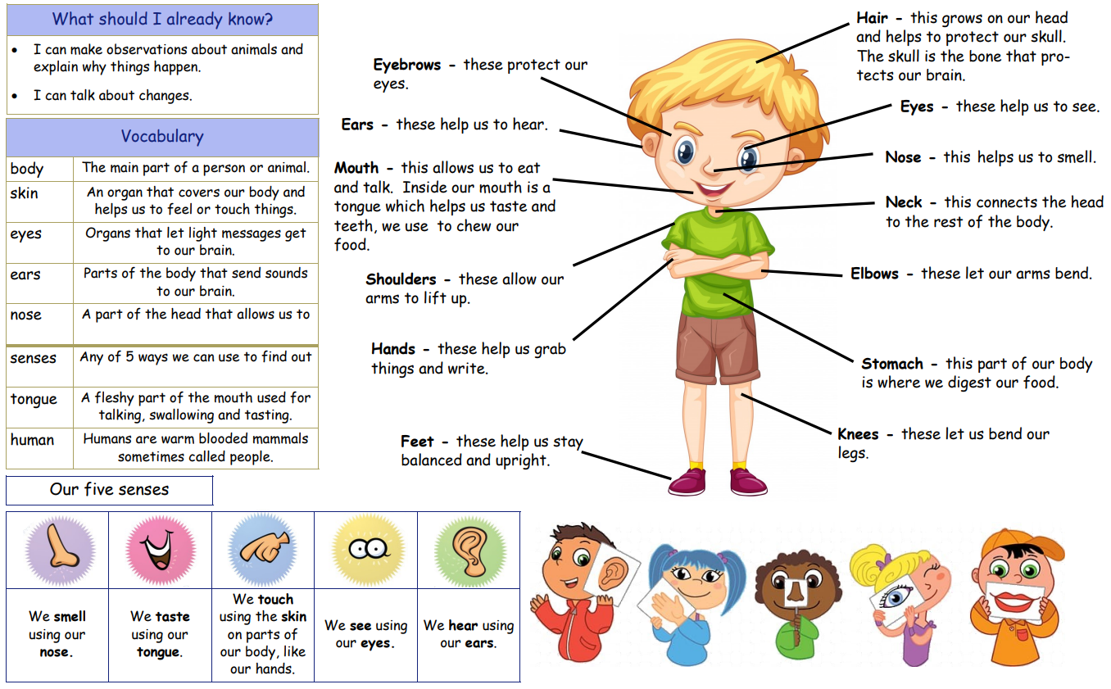
Year 1 Summer 1
Animals including Humans
smell
what is around us.

Slide 2
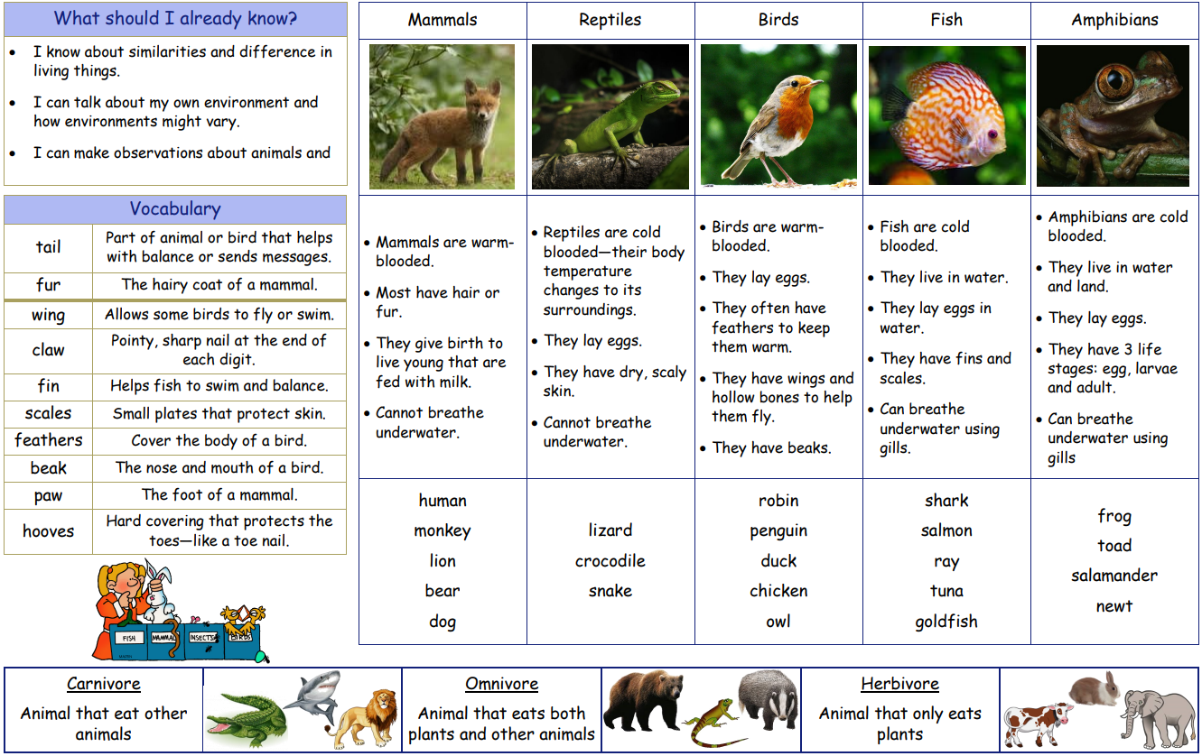
Year 1 Summer 1 and 2
Animals including Humans

