Slide 1
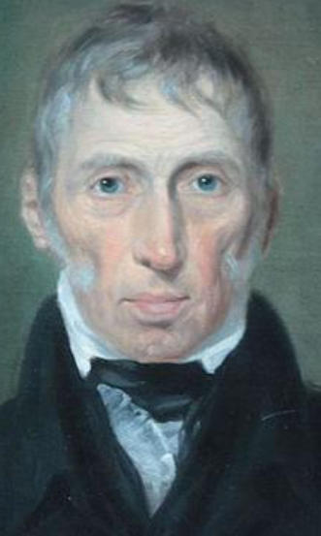
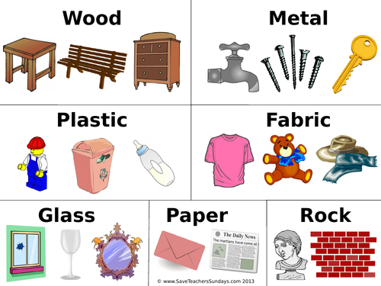
Year 1 Autumn 2 – Everyday Materials
Science
Opaque
Shiny
Hard
Soft
John McAdam
29 May 1827 – 2 September 1865
Inventor of tarmac
Stretchy
Vocabulary | Definition
Hard | Solid and firm to the touch.
Soft | Not hard, easy to manipulate.
Stretchy | Easy to pull to make longer.
Shiny | Having a smooth, glossy surface.
Dull | Not bright.
Rough | Not smooth.
Smooth | Having an even surface.
Bendy | Flexible.
Opaque | Not being able to see through.
Smooth
Rough
Bendy

