Slide 1
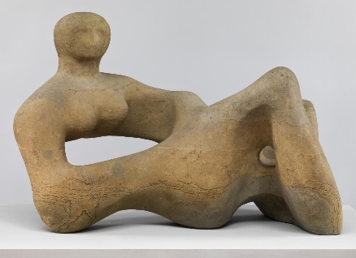
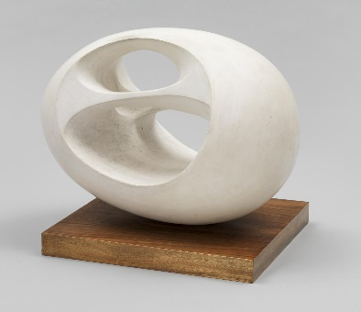
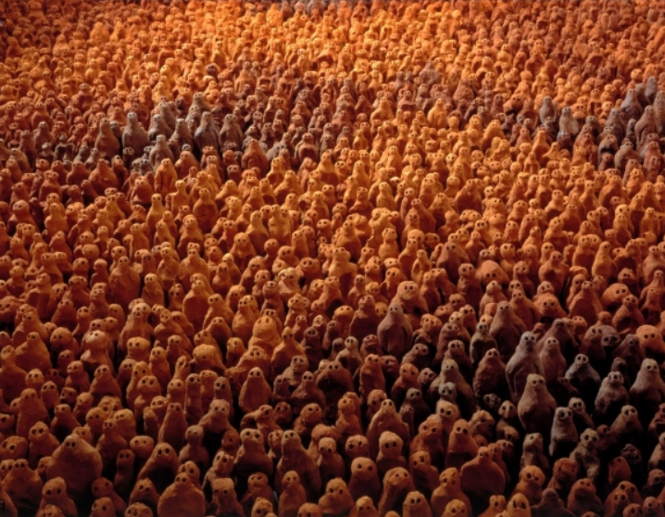
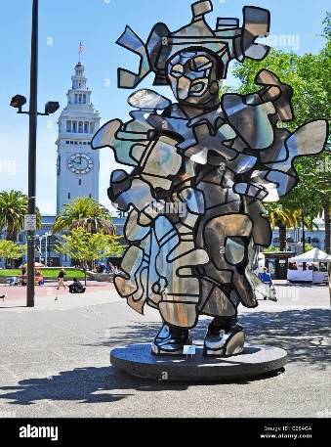
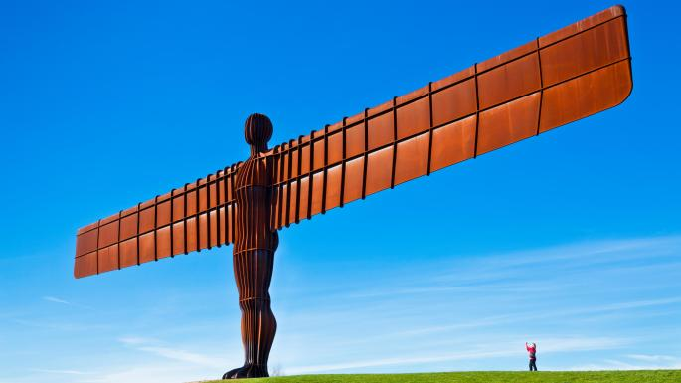
Henry Spencer Moore
The Recumbent Figure – 1938
A sculpture carved from English stone.
Year 2 Spring 2: Art How do artists show still life?
Barbara Hepworth
The Oval – 1943
A sculpture carved from plain wood and painted white.
Antony Gormley
Field for the British Isles – 1993
40,000 individual terracotta figures.
Jean Dubuffet
La Chiffonnière – 1978
A sculpture created from stainless steel.
Vocabulary | Definition
Abstract | Using shapes, colours and marks to produce art
Sculpture | Forming solid objects to represent a person or idea
3-Dimensional | A solid object that has height, depth and length
Assemblage | A collection of objects put together
Collage | Art made by sticking different materials such as fabric or paper onto a backing
Mould | To form an object out of a malleable material
Carve | To make something by cutting into it
Chisel | A tool with a long metal blade
Antony Gormley
The Angel of the North - 1998.
A sculpture made from steel.

