Slide 1

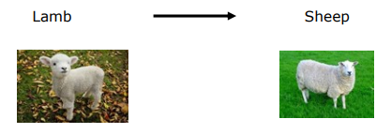
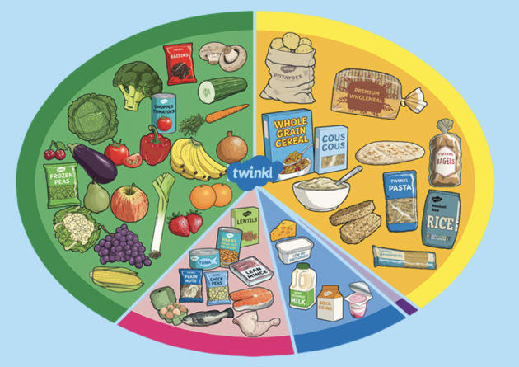

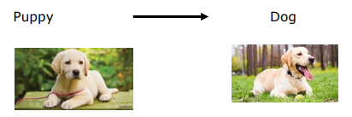


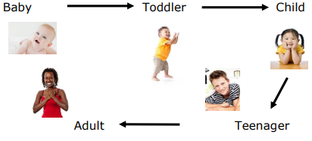
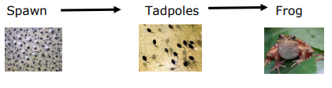
Year 2 – Animals including Humans
Animals, including humans, have offspring.
All animals, including humans, need 3 basic things to stay alive
Air
Water
Food
To grow into healthy adults we need to eat the right foods in the right amounts.
Vocabulary | Definition
Food Chain | A sequence showing the order in which living things depend on each other for food. Starting with a plant and ending with an animal.
Shelter | What people and animals use to protect themselves from their surroundings or predators.
Habitats | Places where animals, humans and plants live suited to their needs to keep them safe.
Ocean | A habitat that some animals live in.
Rainforest | A habitat that some animals live in.

