Slide 1
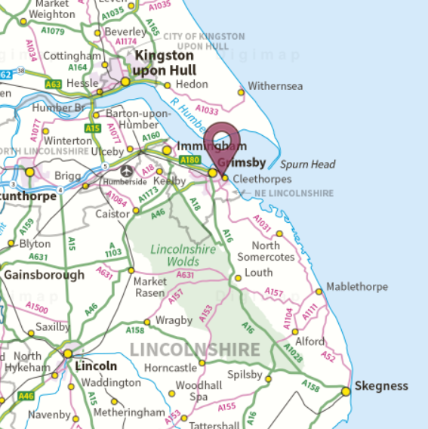
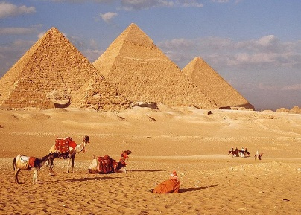
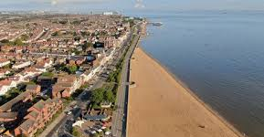
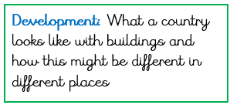
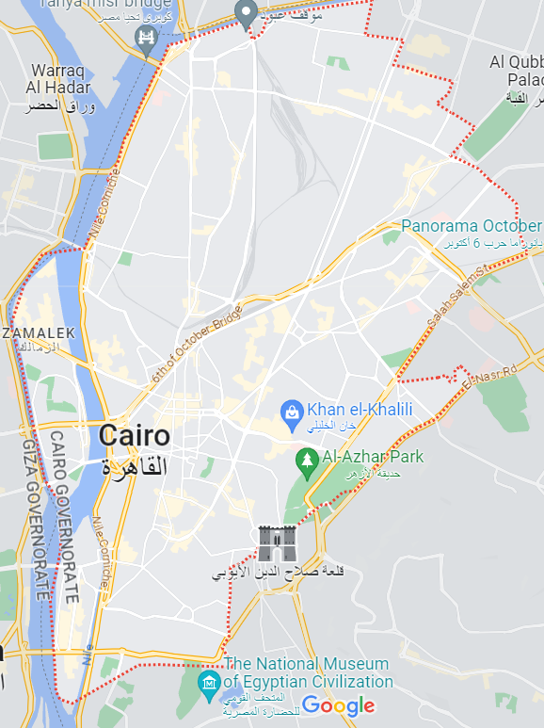
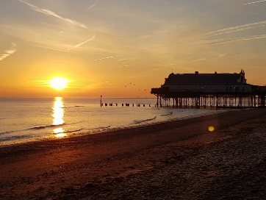
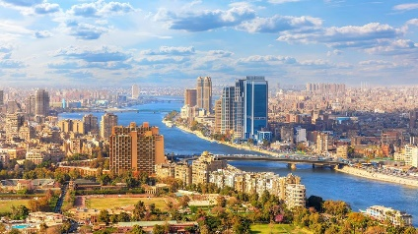
Y2 T3 Where would you rather live: Cleethorpes or Cairo?
Cairo is densely populated and has a population of 11 million people.
The capital city of Egypt, located on the continent of Africa.
The River Nile is used to transport goods.
It is situated in the North of Egypt on the River Nile.
Located on the East coast of England, in the county of Lincolnshire.
Grimsby is a seaport and used to be the largest and busiest in the world.
Cairo
The industry in Cairo is textiles and food processing.
Grimsby and Cleethorpes have a population of 91,200 people.
Grimsby is very important for food manufacturing in England.
Cleethorpes and Grimsby.
Cleethorpes and Grimsby is on the southern bank of the Humber Estuary.

