Slide 1
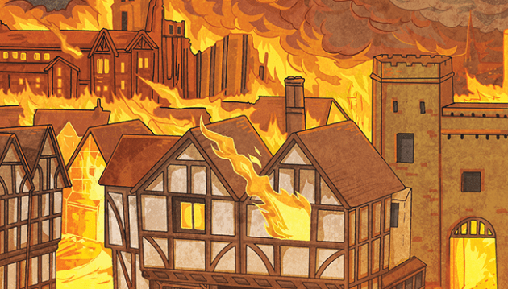
English
Our Power of Reading text this half term will be, Orion and The Dark by Emma Yarlett. In class we will be focusing on two different writing genres: Letter writing and narrative writing.
We will be writing a letter to Orion, the main character of our story, to give him advice and reassurance on his fears. For our narrative piece, we will be innovating our own ideas to create a narrative based on their own character and a fear. We will continue to focus on our spelling using our Year 2 spelling rules in order to produce our high-quality writing.
Maths
In Summer 1, Year 2 will be learning about measuring, including length and height, mass, capacity and temperature. We will be focusing on reasoning and problem solving within these topics as well to deepen the skills we are learning.
As always, at the beginning of our lessons, we will be using our Quick Maths sheets to develop our arithmetic skills and DNAs to recall and retain past learning.
Curriculum – History
This half term in Year 2, as Historians, we will be focusing on the question Why was the Fire of London ‘Great’?
We will be exploring this question through looking at the timeline of events surrounding the Great Fire and looking at significant people such as Samuel Pepys and King Charles II.
We will also be researching into what changed in London after The Great Fire in order for such an event to never take place again.
Bramble Class Newsletter
Summer 1 2024
Science
This half term, Year 2 will continue to investigate plants. The children will deepen their knowledge, following on from their Year 1 learning We will be looking at the germination process of a plant and what plants need to grow. We will continue to observe the seasonal changes happening around us.
Home Reading
Please continue to share both the love of reading books with your child. Encourage them to read their reading book 5 times per week, focusing on building fluency, expression and comprehension. Reads will be counted every Monday.
Reading should be a delightful experience and we encourage you to revisit and re-read favourite books and stories in conjunction with the school reading books. Happy readers become confident readers.
Spelling and Handwriting
Please continue to support your child to practise their spellings and handwriting. All Bramble Class should be using lead-ins and joins for each letter. We will continue to practise this daily in class.
Wider Curriculum
ICT – Information Technology
PSHE – Relationships
Music – Friendship Song.
PE – Outdoor athletics (Sports Day) and Rounders
Our PE Days
Bramble Class will usually have PE on a Monday afternoon.
Please ensure that children have a full PE kit in school that day. Long hair should be tied back, and earrings removed as outlined in the school’s uniform policy on our website.
Homework
Each week the children will be given a History or science task, based on the knowledge organiser.
Please return these to school every Thursday.
Remember that any pupil led ideas, work and out of school achievements will be welcomed and celebrated!

