Slide 1
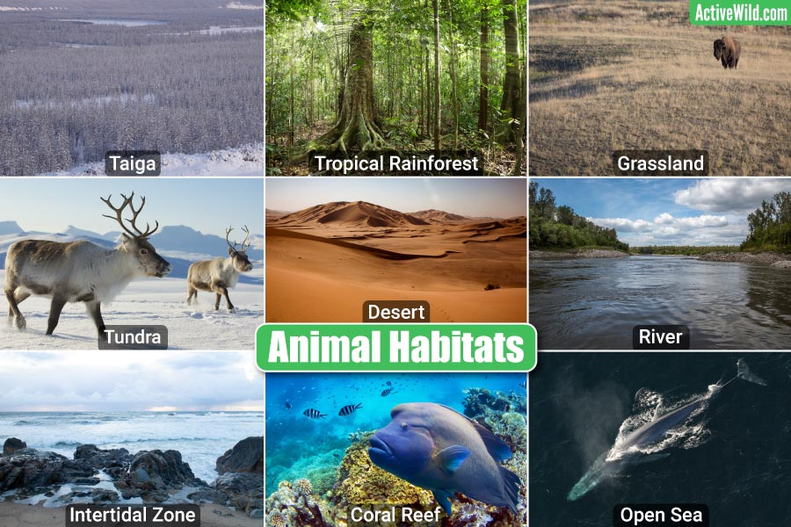
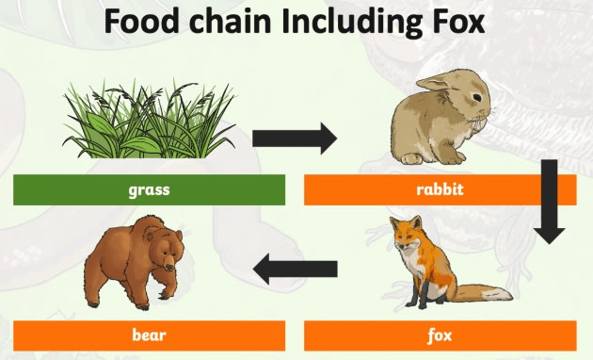
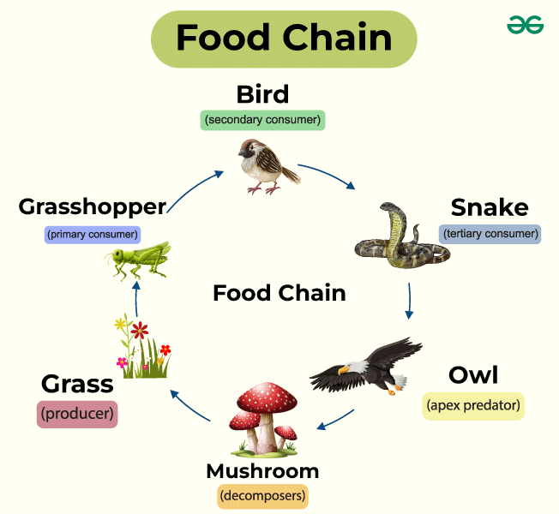
Year 2 – Living things and their habitat
Food chains
All animals, including humans, need 3 basic things to stay alive
Air
Water
Food
Habitats – the natural home or environment of an animal, plant or organism.
Vocabulary | Definition
Food Chain | A sequence showing the order in which living things depend on each other for food. Starting with a plant and ending with an animal.
Shelter | What people and animals use to protect themselves from their surroundings or predators.
Habitats | Places where animals, humans and plants live suited to their needs to keep them safe.
Ocean | A habitat that some animals live in.
Rainforest | A habitat that some animals live in.

