Slide 1
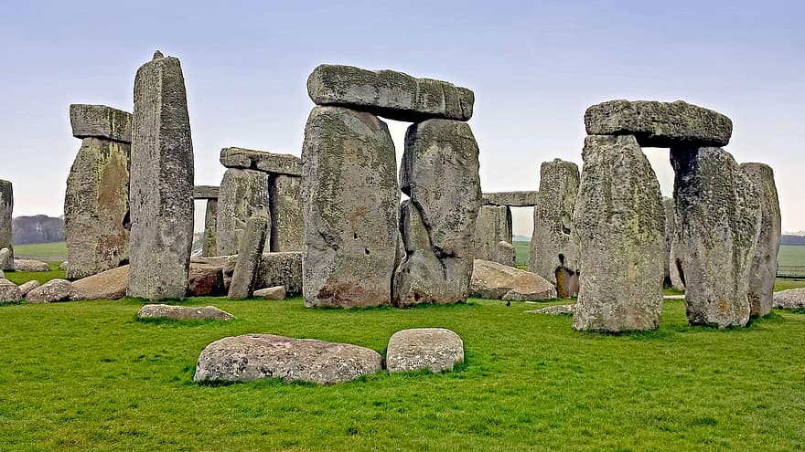

English
In English we will be reading our Power of Reading text, ‘UG’ by Raymond Briggs, which links nicely with our History topic.
We will develop our knowledge of Year 3 spelling, grammar and punctuation. Year 3/4 words will be put on Dojo so that children can practise their spellings at home. In school, we will be using the reading programme ‘Reading Plus’ to develop our reading and comprehension skills. Spelling Shed is an exciting tool that can also be used at home to practice spellings.
During all lessons, we will continue to focus on a high standard of presentation, including joined handwriting.
Curriculum – History
This half term in Year 3, our History focus enquiry question will be:
‘How do we know what it was like in the
Stone Age, Bronze Age and Iron Age?”
We will build a rich knowledge base of historical knowledge including how life changed throughout the Stone Age to the Iron Age. We will also investigate significant monuments, events and artefacts using primary and secondary sources to widen and deepen our understanding of the time period.
Maths
In Year 3 this term we will continue to develop our knowledge of place value and apply that knowledge to 3-digit numbers. We will also deepen our understanding of addition and subtraction of 3-digit numbers.
Please continue to support your child to practise their recall of times tables 2’s, 3’s, 5’s and 10’s. We will begin to learn times tables 4’s, 6’s, 7’s, 8’s and 9’s this year as well. The ability to recall these facts more confidently would be hugely beneficial for your child in their Maths lessons.
Year 3 Newsletter
Autumn 1 2023
Our PE Days
Our PE morning is every Thursday. Please ensure that children have correct full outdoor and indoor PE kit in school all week. Long hair should be tied back and earrings removed as outlined in the school’s uniform policy on our website. Plasters over earrings are not permitted for health and safety reasons.
Science
This term Year 3 will learn about ‘Rocks'! We will explore the rock cycle and learn about different types of rock. We will sort rocks and group them from their properties.
Learning Outcome
At the end of this half term, the children will be producing a non-chronological reports consolidating their knowledge from our History topic.
Reading
Please continue to share the love of books with your child. Encourage them to read/share books at least 5 times per week. This can be recorded on one page per week of the Reading Record. Reads will be counted as they are sent in on your child’s specified day (as last year).
Reading should be a delightful experience and we encourage you to revisit and re-read favourite books and stories.
Wider Curriculum
Computing – E-Safety
PSHE – Being Me in My World.
Music – Three Little Birds – Historical context of
musical styles.
PE – Gymnastics-Body Management/ Games-Invasion
Homework
Each week the children will be set homework, one piece each of English and Maths on a Friday to be submitted by the following Thursday. There will also be a short piece of History and/or Science recall work as well. Homework is a consolidation of what we have been learning in the week. Please share on Dojo anything you get up to outside of school that you would like to share.

Slide 2

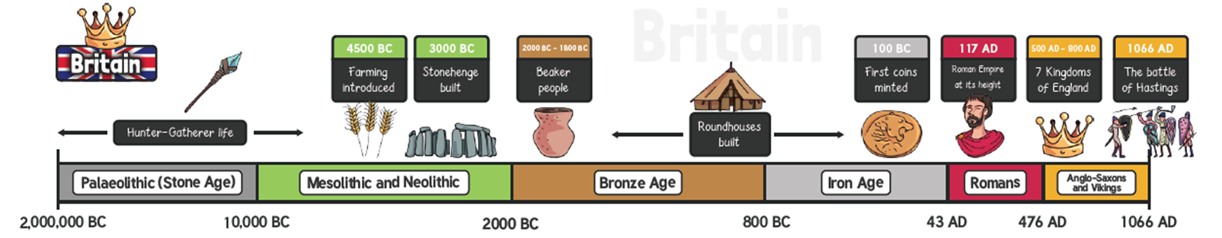
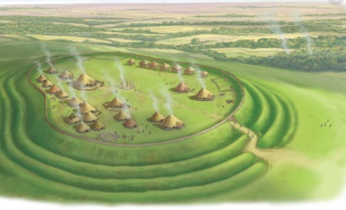
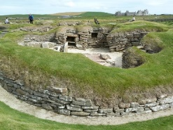
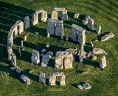
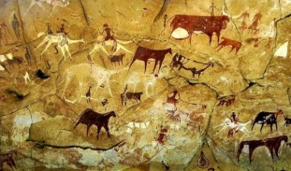
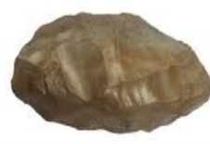
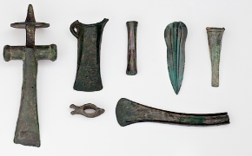
Y3 Autumn 1 2023
How do we know what it was like to live in the Stone Age, Bronze Age and Iron Age?
Hillfort
Vocabulary Dozen​
archaeologist​ | Person who learns about the past by digging up artefacts and studying them. ​
primary source​ | The main source of information about a topic. ​
period​ | A length of time covering many years. ​
settlement​ | A place where a group of people live together in many buildings. ​
forage​ | To search for food. ​
preserve​ | To keep something in good condition. ​
monument​ | Something built to remember an important person or event. ​
trading​ | The act of buying and selling goods and services (for example food). ​
alliances​ | A group of countries or groups of people who work together.​
tribes​ | A group of people that live together for protection. ​
hill forts​ | A settlement surrounded by ditches. ​
invade​ | To enter another country by force. ​
The Stone Age It was a very long period of time. Split into three periods: Palaeolithic (The Old Stone Age - Prehistoric), Mesolithic (Middle Stone Age) Neolithic (New Stone Age). People were hunter-gatherers and were nomadic until they began farming. People lived in Europe for the first time. Stone tools used.
The Bronze Age Bronze was used instead of stone to make tools and weapons in 2500BC People were buried with their important possessions. People started to farm the land.
The Iron Age Iron was used instead of Bronze to make tools and weapons as its shape could be changed. Settlements were often under attack and there were many wars. They lived in tribes in hillforts for protection. 43AD - The Romans invaded Britain.
Skara Brae, Scotland | Well preserved Stone Age village in Orkney, Scotland. One room in each of the 8 houses made of stone.
Stonehenge, England | Famous Stone Age monument located in Wiltshire. Circle of very large stones standing upright Some people believe it was built to learn about the movements of the Sun and Moon. Some people believe it was a burial ground.
Cave Paintings
Flint
Bronze Tools

Slide 3
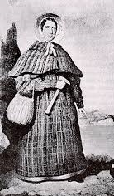
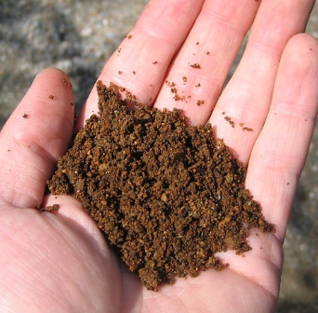
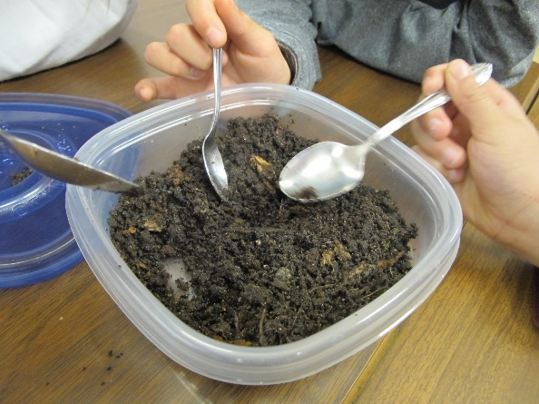
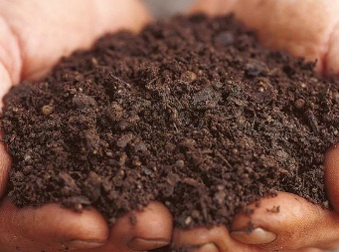
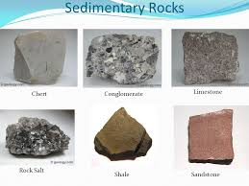
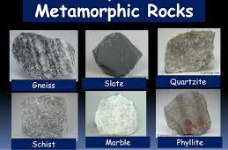
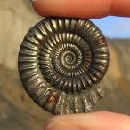
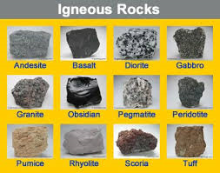
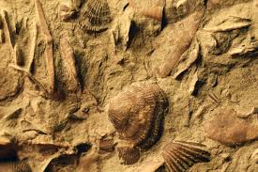

Science -Materials - Rocks
Year 3 Autumn 1
Vocabulary and meanings
fossils | The remains or impression of a prehistoric plant or animal embedded in rock and preserved in petrified form
sedimentary rock | Rock that has formed through the deposit and hardening of sediment
metamorphic rock | Rock that has changed over time under the influence of heat, pressure, or some other agent without passing through a liquid phase.
igneous rock | Rocks formed by the cooling and solidifying of molten materials
palaeontology | The study of fossils as a guide to the history of life on Earth
anthropic | Involving or concerning the existence of humans
permeable | A material allowing liquids or gases to pass through.
impermeable | A material that does not allow gases or liquids to pass through.
Timeline of
Mary Anning’s life
Born 21st May 1799 in Lyme Regis, Dorset
1811 – discovered the skeleton of a dinosaur
1823 – discovered the first Plesiosaurus skeleton
1828 – discovered the first Pterodactylus
1847 – Mary Anning died aged 47

