Slide 1
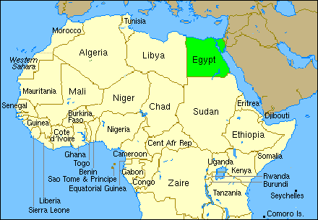
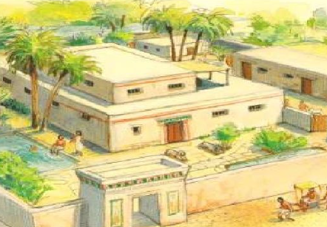
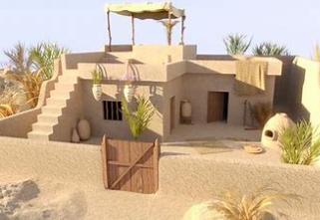
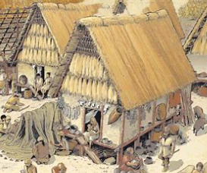
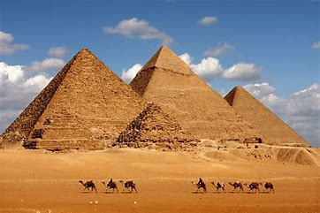
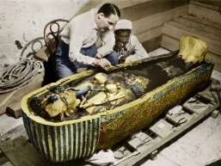
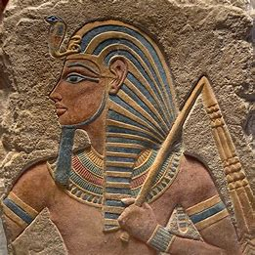
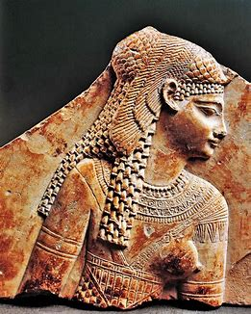
Year 3 Summer 1 – History
What do the pyramids tell us about Ancient Egypt?
Vocabulary
civilisation | A human society with its own social organisation and culture
era | An extended period of time in years
tomb | A vault, chamber or grave for the dead
mummification | To preserve the body of a human or animal
pharaoh | A king of Ancient Egypt
pyramid | An ancient stone building with four triangular sides and a square base
government | The system or form by which a community is ruled
source | The point or place from which something originates
empire | A group of countries controlled by one ruler
invade | Entering a place or country by force
Home of the rich, average and poor.
Egypt is located in Northeast Africa and the capital city is called Cairo.
The River Nile is the longest river in the world (over 4000 miles long).
The Nile flows through Africa to the Mediterranean Sea.
Pyramids were built as tombs. They have told us lots about the time.
Howard Carter discovered the tomb of Tutankhamun in 1922.
We know about Ancient Egypt from archaeologists excavating the tombs where pharaohs were buried along with their weapons, clothes and jewellery.
The valley of the kings along the river Nile has 60 tombs that have been excavated.
Cleopatra
(69BC – 30BC)
Last Pharaoh of Ancient Egypt before the Romans invaded
Tutankhamun
(1332BC – 1322BC)
Pharaoh at 9 years old
His reign lasted 10 years

