Slide 1
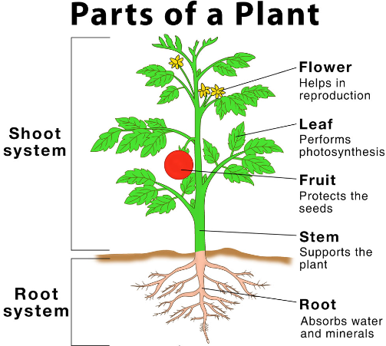
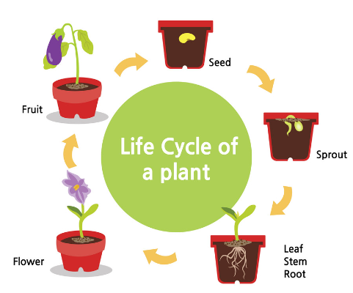
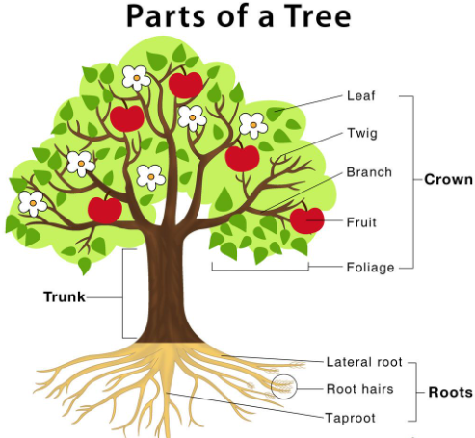
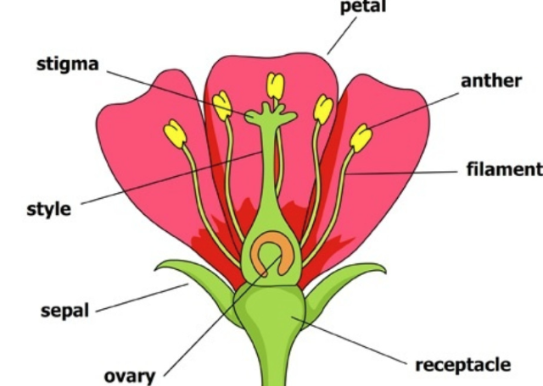
Year 3 – Plants
Vocabulary Dozen
nutrient | a substance absorbed by plants for nourishment
reproduction | the process by which an animal or plant produces smaller versions similar to itself
pollination | the transfer of pollen from the anther to the stigma
dispersal | the spreading of things over a wide area
stamen | the centre of a flower that produces the pollen
stigma | the centre part which takes in pollen
anther | part of the stamen where the pollen is collected and allowed to mature
photosynthesis | the way green plants make their food using sunlight
chlorophyll | the green substance in plants which enables it to use the energy from the sunlight in order to grow
seedling | a young plant that has grown from a seed
anchor | to fix something so it does not move
growth | to increase in physical size and development
energy | the power source that makes things work and move
flower | part of the plant which is brightly coloured and grows at the end of the stem
How do they grow?
What do plants need to grow, survive and be healthy?

