Slide 1
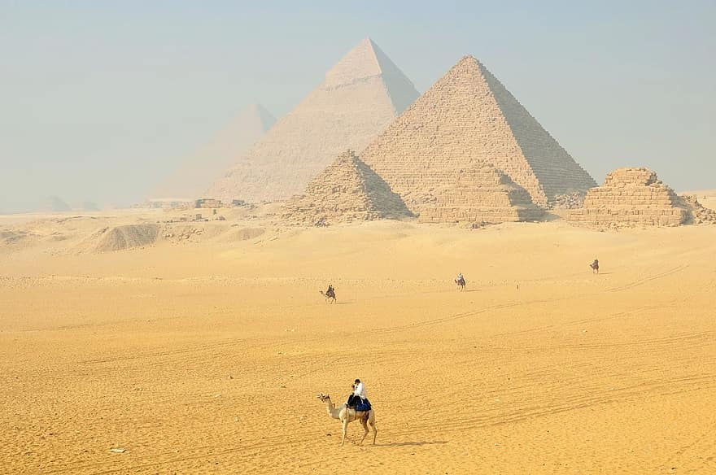
English
In English we will continue to develop our writing skills. Our story is The Miraculous Journey of Edward Tulane.
We will consolidate and improve our knowledge of sentence structures including different types of sentence. We will practice writing for different purposes and audiences.
We will develop our knowledge of Year 3
spelling, grammar and punctuation. During all
lessons, we will continue to focus on a high standard of presentation, including joined handwriting. We will further develop our editing and improving skills.
Curriculum – History
This half term our history focus will be on Ancient Egypt. Our enquiry question will be:
What do the pyramids tell us about Ancient Egypt?
Our knowledge will build as we explore when, what and who. We will learn about daily life, the rulers and two examples of leaders. Learning outcome: As our project comes to an end we will write an educational quiz for KS2 children.
Maths
In Year 3 this term we will be learning about mass, capacity, shape money and time.
Please continue to support your child to practise their recall of the number bonds to 100 and their 2, 3, 4, 5, 8 and 10 times tables. We will be using TT Rockstars to aid this. The ability to recall these facts more confidently are hugely beneficial for your child in their Maths lessons.
Year 3 Newsletter
Summer 1 2024
Science
This term Year 3 will learn about ‘Plants’. We will be able to observe the life-cycle of a plant and identify the functions of a flowering plant, understand how plants reproduce and how they make their own food. We will also continue to develop our scientific investigation skills.
Our PE Days
Our PE time is on FRIDAY morning. Please ensure that children have correct full outdoor and indoor PE kit in school. Long hair should be tied back and earrings removed please as outlined in the school’s uniform policy on our website.
Design and Technology
Our DT enquiry question is:
‘Can we create an Italian inspired pizza?’
Reading
Please continue to share the love of books with your child. Encourage them to read/share books 5 times per week. This should be recorded in the Reading Record please. Reads will be counted every Thursday when books are handed in.
Reading should be a shared, happy experience.
Happy readers become confident readers and learners – reading helps in all areas of the curriculum.
Wider Curriculum
ICT – Scratch backdrops, sprites and programming movements of the sprites
PSHE – relationships
Music – glockenspiels – Bringing Us Together
PE – Outdoor Athletics and Rounders
Homework
Each week the children will be set homework on a Friday to be returned by the following Thursday. This will be sent home in the blue Home Learning book. Children should practise learning times tables on TTRS.
There will be a short piece of Topic recall work.

