Slide 1
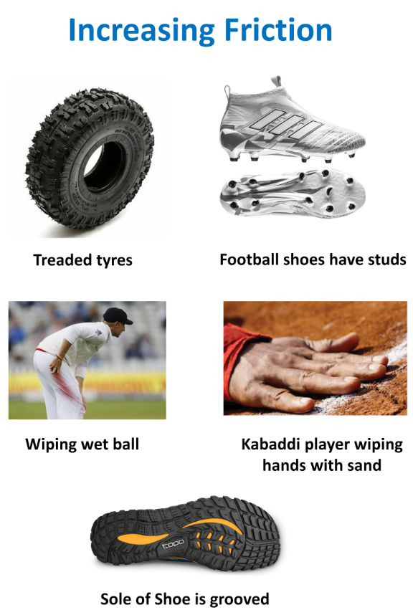
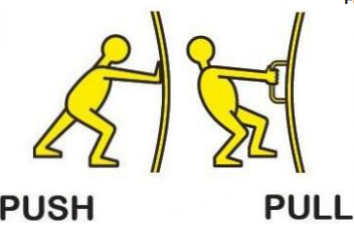
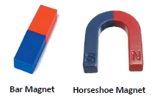
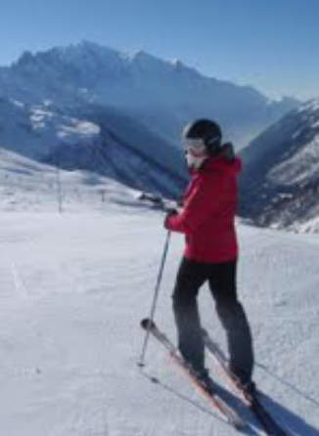
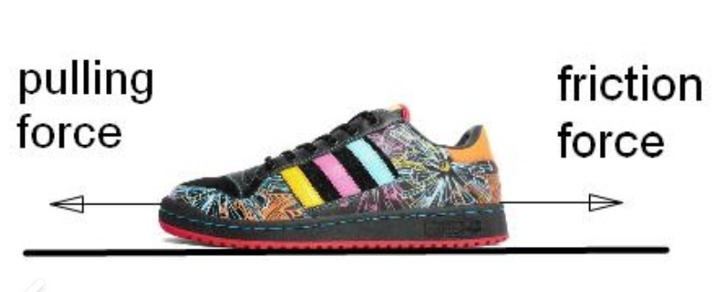
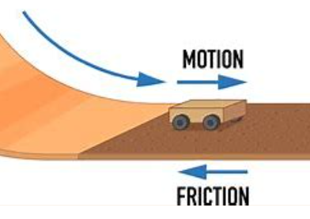
Middlethorpe Primary Year 3 Spring Term 2: Forces – Friction and Magnets
Vocabulary Dozen
attract | To pull towards. Opposite of repel.
pull | A force used to pull an object towards another.
repel | To push away. Opposite of attract.
push | A force used to push an object away.
pole | Ends of a magnet. One is North and the other is South.
magnet | Object that pulls or pushes things with an invisible force called magnetism.
force | The push or pull on an object
compass | An instrument to help follow directions using a magnetic needle that always points North.
magnetic | The force of attraction and repelling caused by a magnet.
friction | The rubbing of one object against another.
gravity | A force that causes things to drop to the ground.
surface | The outside edge of an object.
All forces are pushes or pulls.
Key Questions we will investigate
Which has more friction, a skater or a runner?
When do we need less friction?
When do we need more friction?
There are many types of magnets.
Why do runners need friction?
Friction acts upon moving things.
Do skiers need friction?

