Slide 1
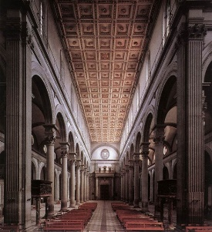
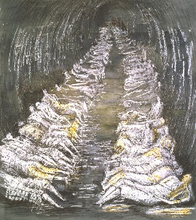
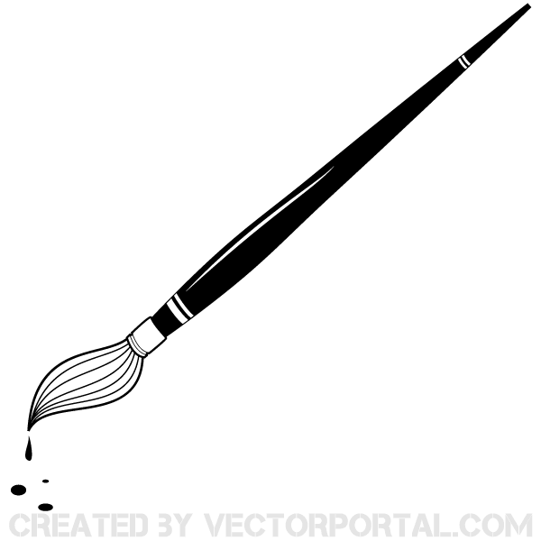
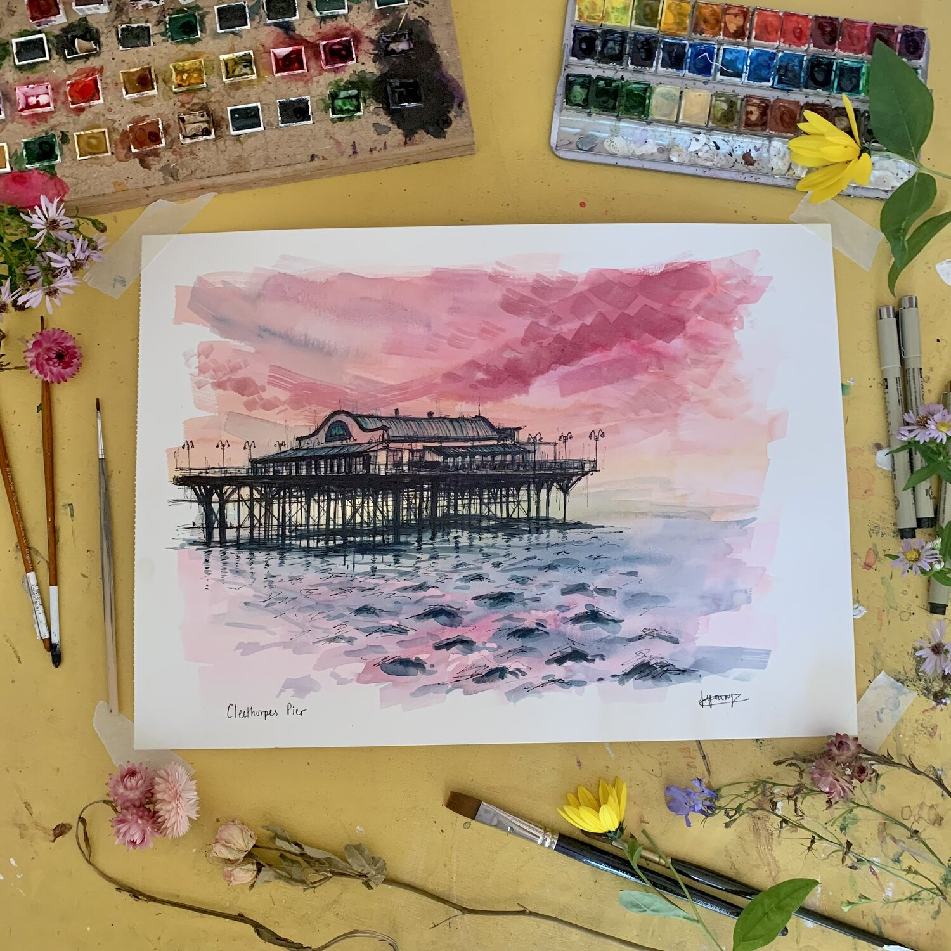
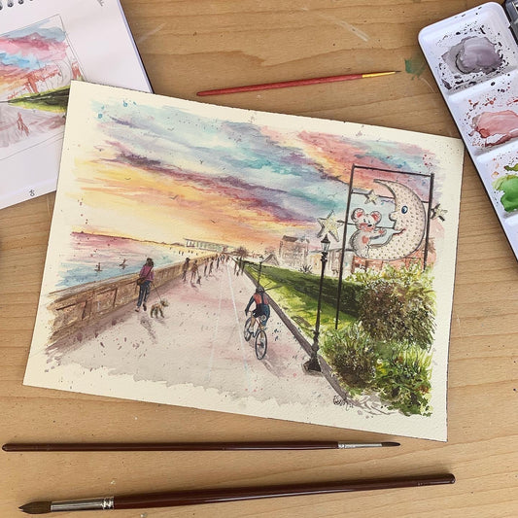
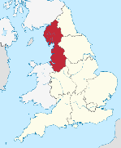
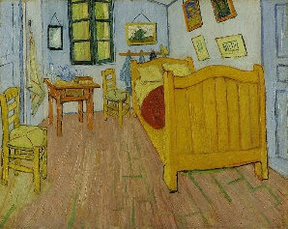
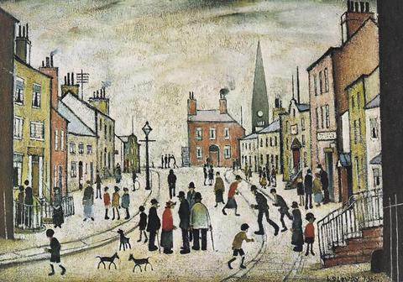
Perspective – Showing a 3D objects’ height, width, depth and position on a 2D surface
Linear – arranged in a straight or nearly straight line
Parallel – always having the same distance between two lines
Converge - to meet at a point
Horizon – where the earth’s surface and sky appear to meet
Vanishing point – where parallel lines viewed in perspective appear to converge
Construction lines – temporary lines that allow objects to be drawn in perspective
Tube Shelter
Perspective
1941
Florence
Cathedral Dome
1446-1461
The Nave
of the Church
1419
Henry Moore
Filippo Brunelleschi
Nave – Middle
part of a church
How do artists use perspective?
Local Artists
Francesca Young
Vincent Van Gogh
LS Lowry
Post-Impressionism
Renaissance – European art and literature from the 14th-16th century (1301-1600)
Realism – To represent the subject truthfully
Impressionism – To re-create the feeling of a scene
Eve Leoni
Bedroom in Arles
1888
Life in industrial areas
A Village Square
1943
Matchstalk Men and Matchstalk Cats and Dogs
Industrial – Linked to processing raw materials and manufacturing
goods in factories
♫

