Slide 1

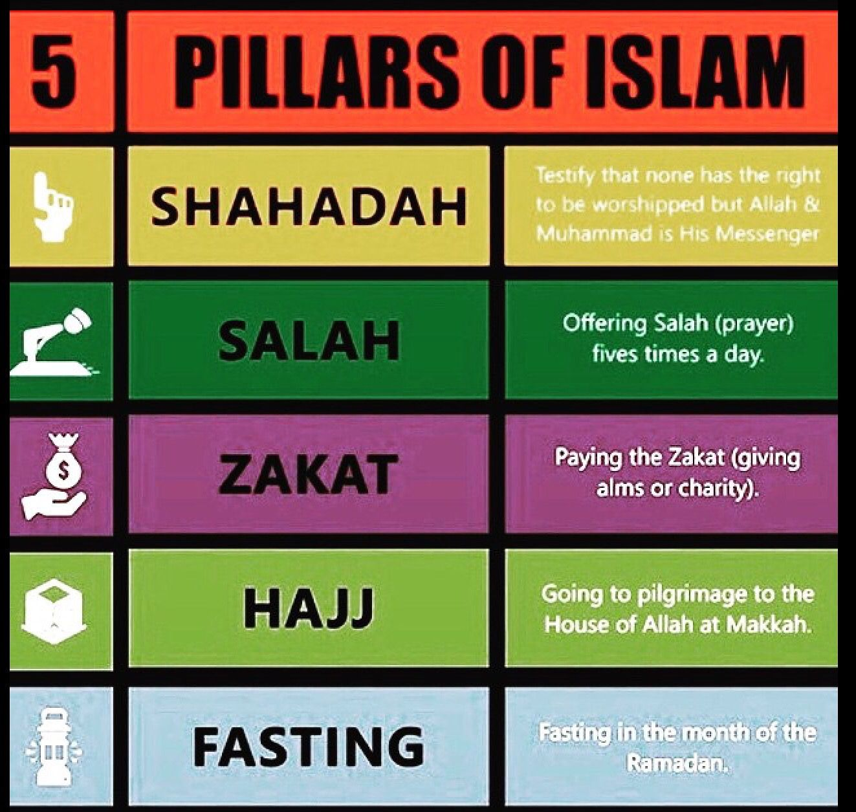
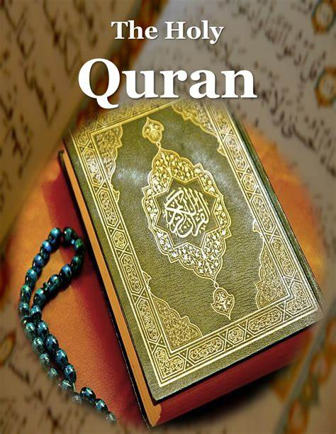
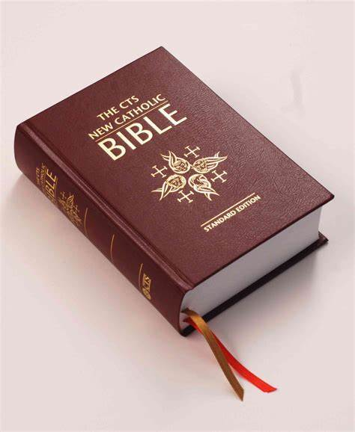
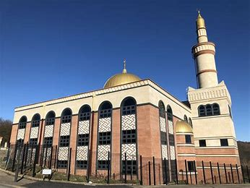
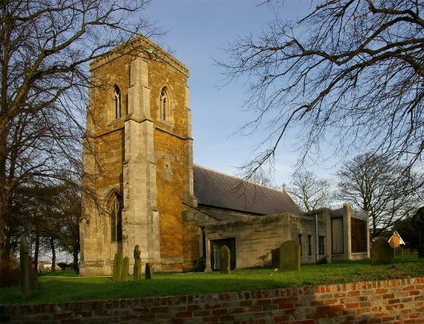
Year 6 Term 2:
Why is it important to understand and evaluate different religions?
Can you remember them along with their meaning?
Quran: Islam Holy Book | Bible: Christianity Holy Book
Vocabulary Dozen
Faith | Loyalty and trust in a person or God.
Belief | An acceptance that something exists or is true.
Eternity | Infinite or unending time.
Prophet | A person who teaches about God.
Peaceful | Not involving war or violence; tranquil.
Pilgrimage | A journey that someone goes on to expand their faith and self meaning.
Fasting | Don’t have all or some kinds of food or drink, especially as a religious observance.
Worship | To live life connected to and thinking about God.
Taqiyah | A small cap worn by some Muslims (especially when they prey).
Imam | Imams led worship in Mosques.
Resurrection | The rising of Christ from the dead.
Crucifixion | Sn ancient form of execution in which a person was nailed or bound to a cross.
The Qur’an teaches Muslims to lead peaceful lives. | Mary was chosen by God.
Muhammad was the prophet messenger of God. | Christians believe in an afterlife.
The Qur’an teaches Muslims to lead peaceful lives | God created the heaven and the earth.
Mosque: A place of prayer for Muslims.
Church: A place of prayer for Christians.

