Slide 1
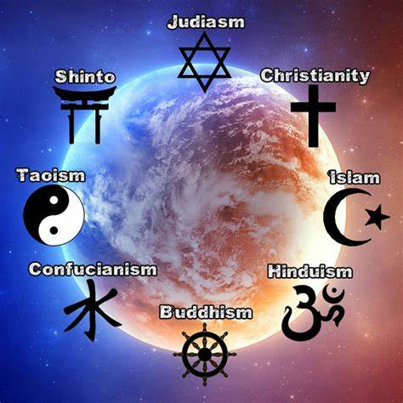



Maths
In Year 6 this term, we will be working with fractions. The children will study a variety of areas from simplifying fractions, to adding mixed numbers, to dividing fractions by whole numbers and much more.
Please continue to support your child to practise all of their times tables as a secure knowledge underpins the majority of what we do in Year 6. The ability to recall these facts more confidently would be hugely beneficial for your child in their Maths lessons and eventually their SATs.
English
In English, we will be reading our Power of Reading text ‘Wonder’. Our written work will focus on a range of short-burst writes, leading up to our final pieces, which will be an explanation text and recount narrative.
We will continue to develop our knowledge of Year 6 grammar and punctuation.
In school, we will be using the Scode spelling scheme to set and assess our spellings.
During all lessons, we will continue to interrogate a variety of texts, attempt to broaden our range of vocabulary and further develop our writing styles.
Curriculum – RE
This half term focus is: ‘Comparing Religions’.
Our enquiry question is: ‘Why is it important to understand and evaluate different religions?’
Each termly focus will be supported by a knowledge organiser (will be shared separately). This provides each child with the key facts and vocabulary for each topic. The children will be encouraged to learn these facts and they will be revisited regularly with the intention of the children acquiring them in their long-term memory.
Year 6 Newsletter
Autumn 2 2024
Science
This half term Year 6 will study Light and Sight. Within this topic, they will complete a huge range of exciting work from creating their own periscopes to investigating shadows and how they are created.
Reading
Please continue to share the love of books with your child. Encourage them to read/share books 5 times per week. This can be recorded on one page per week of the Reading Record. Reads will be counted every Friday. Reading should be a delightful experience and I truly believe there is a book out there for everyone. Please support us in encouraging your child to read as it opens up so many doors.
Learning Outcome
Why is it important to understand and evaluate different religions?
Wider Curriculum
ICT – Information Technology/ Making an App
DT- Food culture
PHSE – Celebrating Differences
Music – Singing.
PE: Dance- Interpretive dance and Indoor Athletics
MFL- Spanish
Our PE Days
Our PE lessons will be on a Thursday afternoon. Children will be changing into their PE in school therefore please ensure that children have a full outdoor and indoor PE kit in school all week. Long hair should be tied back and earrings removed as outlined in the school’s uniform policy on our website.
Homework
Each week the children will be set one piece of homework linked to their RE or Science Knowledge Organiser. Children will also receive English and Maths, which we will inform you about on Class Dojo. Homework will be handed out every Friday and it will need to be returned by Thursday the following week.

