Slide 1
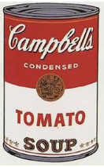
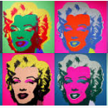
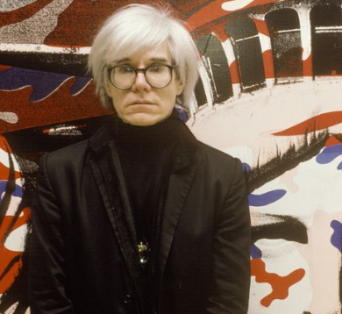
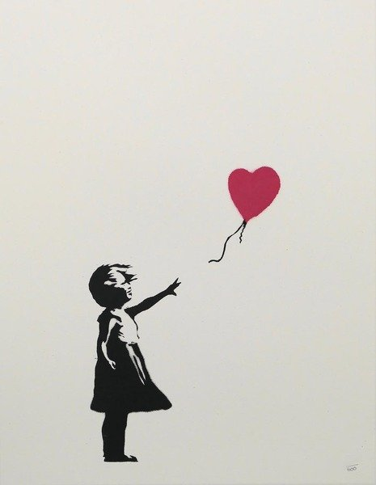
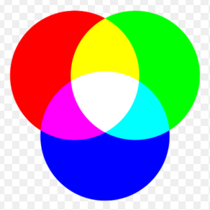
Year 6 Term 3: How do artists express modern life?
Vocabulary Dozen
Triplet | a set or succession of three similar things
Pop Art | art based on modern popular culture and the mass media, especially as a critical or ironic comment on traditional fine art values
Advertising | the activity of creating advertisements and making sure people see them
Popular culture | the general culture of a society, including ideas, music, books, and the mass media, as opposed to high culture
Irony | the humorous or mildly sarcastic use of words to imply the opposite of what they normally mean.
Screen printing | a method of printing using a fine mesh of silk, nylon, etc, treated with an impermeable coating except in the areas through which ink is subsequently forced onto the paper behind
Stencil | A stencil is a piece of paper, plastic, or metal which has a design cut out of it. You place the stencil on a surface and paint it so that paint goes through the holes and leaves a design on the surface.
Substrate | an underlying substance or layer
Street art | artwork that is created in a public space, typically without official permission
Graffiti | writing or drawings scribbled, scratched, or sprayed illicitly on a wall or other surface in a public place
Vandalism | the deliberate damaging of things, especially public property
Stippling | the art or process of drawing, painting, or engraving using numerous small dots or specks
Andy Warhol
(born Andrew Warhola; August 6, 1928 – February 22, 1987)
Warhol was an American artist, director, and producer who was a leading figure in the visual art movement known as pop art
Campbell’s Soup
1962
Marilyn Diptych’
1962
An epigram is a short saying or poem which expresses an idea in a very clever and amusing way.
Banksy
Banksy is an anonymous England-based street artist, political activist, and film director, active since the 1990s. His satirical street art and subversive epigrams combine dark humour with graffiti executed in a distinctive stencilling technique
RGB Triplet
Exciting Books

