Slide 1
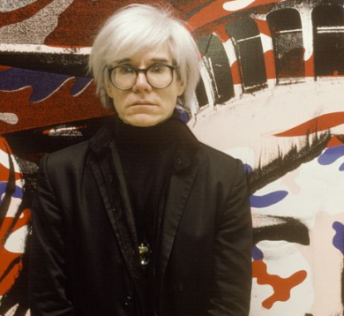
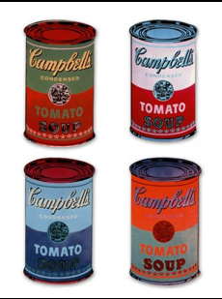
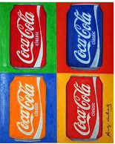
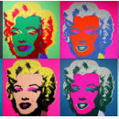
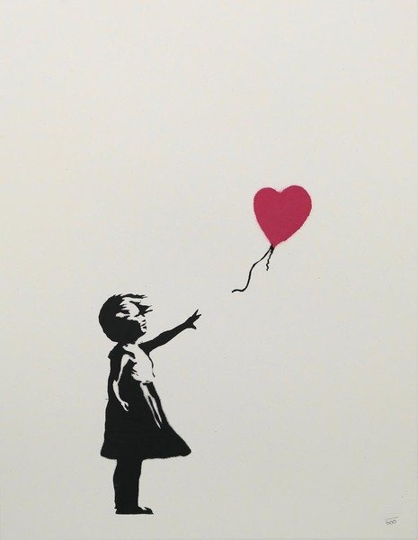
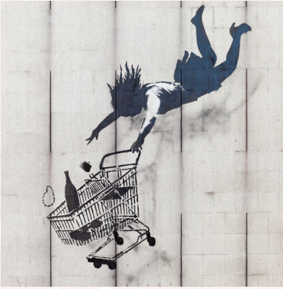
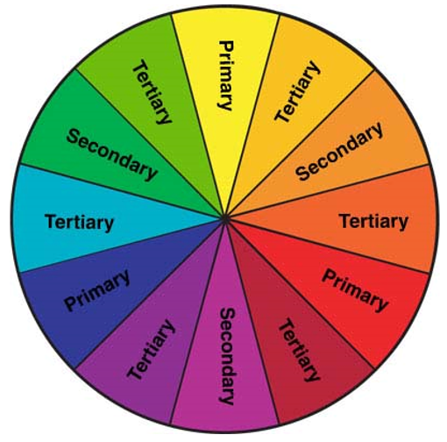
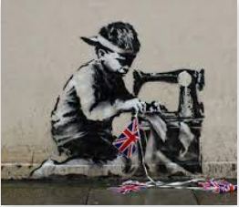
Year 6: How do artists express modern life?
Vocabulary Dozen
Pop Art | art based on modern popular culture and the mass media, especially as a critical or ironic comment on traditional fine art values.
Advertising | the activity of creating advertisements and making sure people see them.
Popular culture | the general culture of a society, including ideas, music, books, and the mass media, as opposed to high culture.
Irony | the humorous or mildly sarcastic use of words to imply the opposite of what they normally mean.
Screen printing | a method of printing using a fine mesh of silk, nylon, etc, treated with an impermeable coating except in the areas through which ink is subsequently forced onto the paper behind.
Stencil | a stencil is a piece of paper, plastic, or metal which has a design cut out of it. You place the stencil on a surface and paint it so that paint goes through the holes and leaves a design on the surface.
Substrate | an underlying substance or layer.
Street art | artwork that is created in a public space, typically without official permission.
Graffiti | writing or drawings scribbled, scratched, or sprayed illicitly on a wall or other surface in a public place.
Vandalism | the deliberate damaging of things, especially public property.
Stippling | the art or process of drawing, painting, or engraving using numerous small dots or specks.
Andy Warhol
Banksy
The Colour Wheel
Complementary colours are colours which are opposite on the colour wheel.
These colours often work well together.
Do we know who Banksy is?

