Slide 1
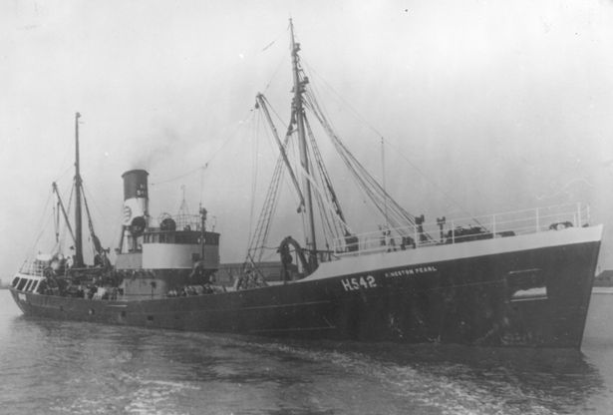
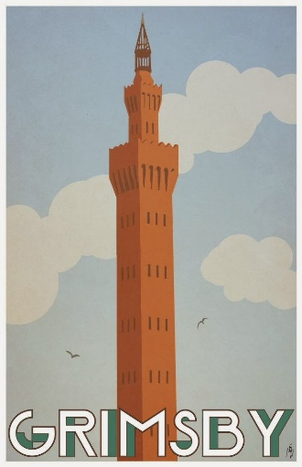

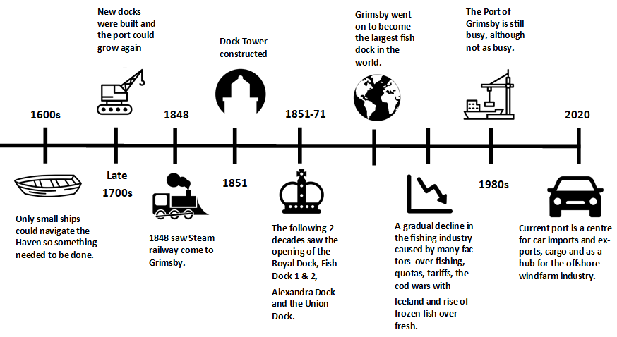
How did Grimsby become ‘GREAT Grimsby’?
Vocabulary Ten
medieval | The period between the end of the Roman Empire in 476 AD and 1500 AD
industry | The collecting of raw materials to produce a product to sell.
magnates | A magnate is someone who has earned a lot of money from a particular business or industry.
navigate | Choosing a course that is safe to follow.
amenities | Useful facilities or services.
constructed | Built or made.
decades | A decade is a period of ten years.
investment | The activity of investing money into a business, industry or area.
prosperous | People, places and economies that are rich and successful.
decline | If something declines, it becomes less in quantity, importance or strength.
Know that fishing has been important to the town of Grimsby since mediaeval times. | Know that railway links to Manchester and Sheffield made a huge difference to the growth of the docks. | Know that over-fishing, fishing quotas led to the gradual decline of the fishing industry. | Know that the current port is a centre for importing and exporting cars in addition to being a base for the offshore wind industry.

