Slide 1
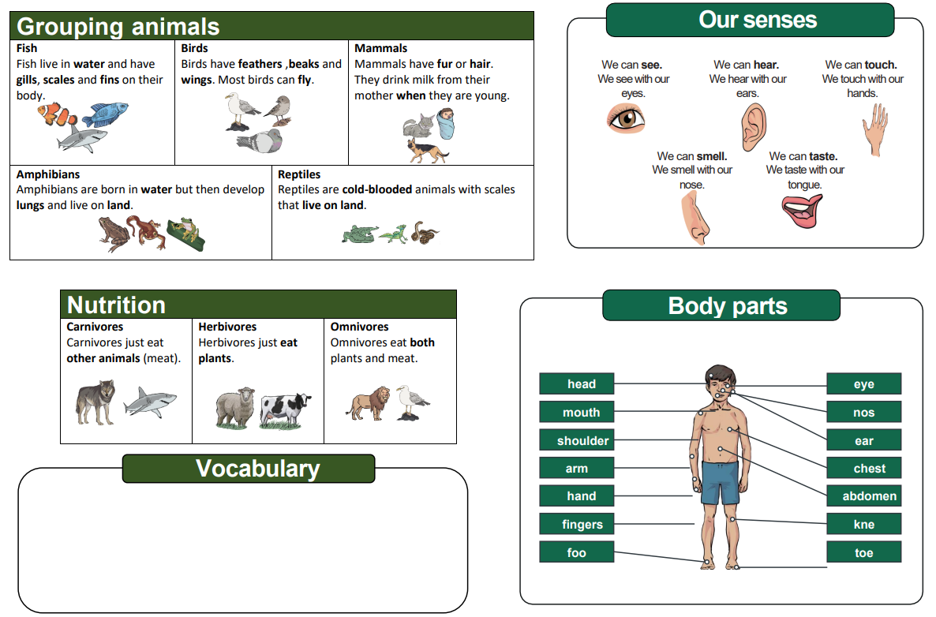
Year 1 – Animals including Humans Knowledge Organiser
Amphibians, birds, fish, mammals, reptiles, carnivores, herbivore, omnivore, sight, hearing, touch, taste, smell, head, neck, ear, mouth, shoulder, hand, fingers, leg, foot, thumb, eye, nose, knee, toes, teeth, elbow.

