Slide 1
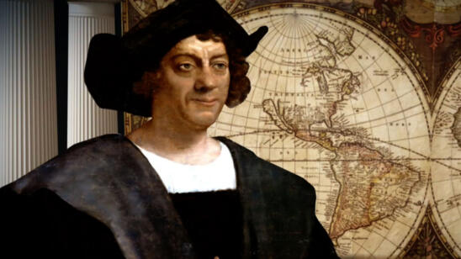
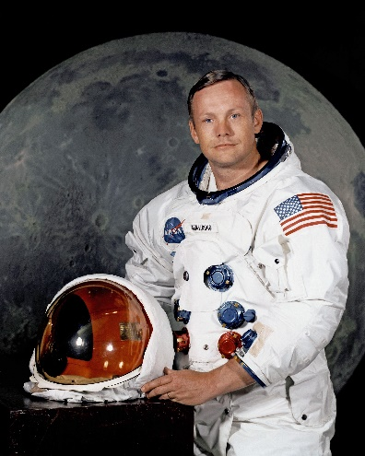
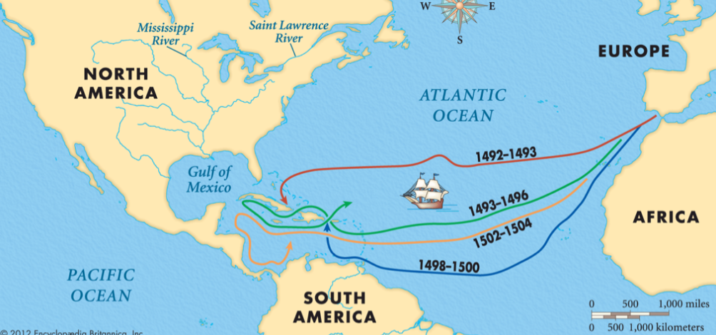
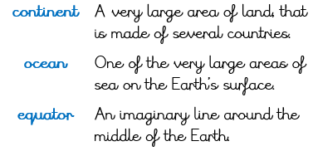
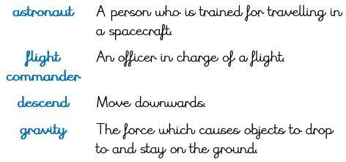
Year 2 Autumn 1 Who is the greatest explorer?
Christopher Columbus
1451 | Born in Genoa, Northern Italy.
Famous Quotes
‘One small step for a man, one giant leap for mankind.’ Neil Armstrong, 1969
Neil Armstrong
1930 | Born in Ohio, United States of America.
August 3rd, 1492 | Three ships called the Santa Maria, the Nina and the Pinta sailed west.
October 12th, 1492 | Columbus found an island and named it San Salvador. He made four further voyages across the Atlantic Ocean.
July 21st, 1969 | Neil Armstrong was the first person to walk on the moon.

