Slide 1
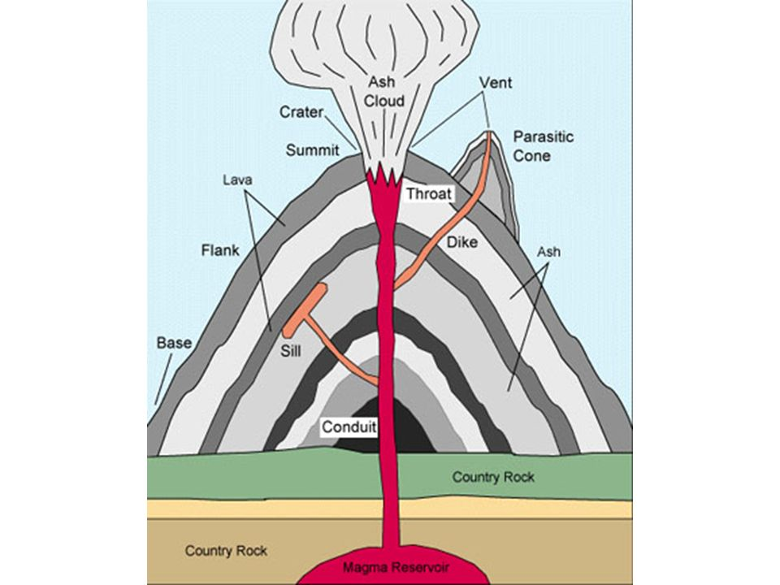
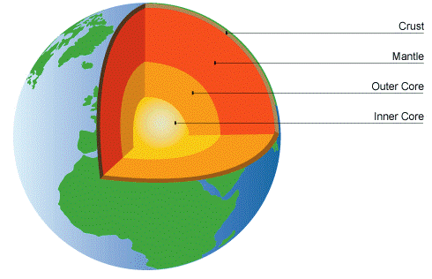
Year 3 – Spring 1 - Geography Why do people live in dangerous places?
The Structure of a Volcano
Vocabulary and Definitions
Crust | Hard outer layer of the Earth.
Eruption | An occasion when a volcano explodes.
Epicentre | Central point of an Earthquake.
Vibrate | To move continuously, to shake slightly and quickly.
Core | The inner most part of the Earth.
Vent | An opening of the Earth’s surface where volcanic materials are released.
Magnitude | A number to show how strong an earthquake is on the Richter scale.
Boundary | A line which marks the edge of an area.
Molten | It’s the melting points of materials Eg: Metal and rock.
Destructive Plate Boundary | Where the plates move towards each other, which may cause a volcanic eruption.
Violent | Very strong or powerful.
Constructive Plate Boundary | Two plates that pull apart, magma gently rises.
Volcano facts
There are 1,500 active volcanoes in the world and about 50 volcanoes erupt every year
Some volcanoes are underwater
There are no active volcanoes in the UK. The largest volcano in Europe is Mount Etna in Sicily (Italy)
The Earth has a crust which is divided into 8 constantly moving tectonic plates.
Volcanoes are usually formed on the boundary between 2 tectonic plates.
Lava and gases are released from the volcano’s vent.
When lava cools it forms igneous rocks EG: basalt, granite and pumice.
Two types of volcano- Shield and composite.
Structure of the Earth
What is an earthquake?
What is ‘magnitude’?
Earthquakes are measure in magnitude – this tells us how strong the tremors were.

