Slide 1

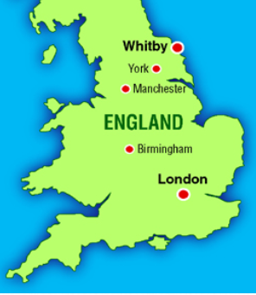
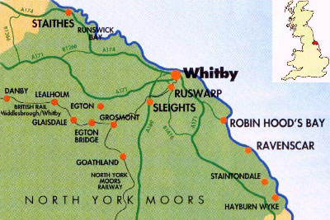

Year 4 Term 6: What makes Whitby wonderful?
Key Knowledge
Vocabulary Dozen
Abbey | A religious place or building
Agriculture | The farming of crops or animals.
Coastal | Something on the shore or seaside.
Gothic Style | Stone structure, sharp pointed spires and pointed arches.
Harbour | An area of water where boats are kept that is protected from waves and currents.
Industrial | Businesses that provide products or services.
Leisure | Time spent away from work relaxing
Moorland | Uncultivated hill land
Pier | A structure built out into the water for people to walk along and get on and off boats.
Tourist | People who travel to a different place other than their home.
Upland | An area of high or hilly land
Valley | A low area of land between hills or mountains
Where is Whitby?
Whitby is a coastal town in North Yorkshire It is close to the North Yorkshire Moors National Park. The town is built on two sides of the River Esk and is very popular with tourists. Around 13 000 people live in Whitby. North Yorkshire is the largest county in England. Whitby has a coastline that is constantly changing.
How is land used in Whitby?
Housing | Industrial
Retail | Agricultural
Leisure | Harbour
Where is Whitby?
What is Whitby famous for?
Black mineral jet - A precious stone used in jewellery. Whitby Abbey – There are 199 steps leading up to it. Gothic style Abbey. This is the setting for part of the Dracula story. Whalebone Arch - This 20ft whale’s jaw bone was erected in 1853.

