Slide 1
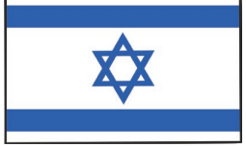
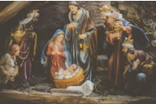
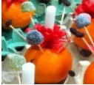
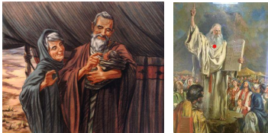
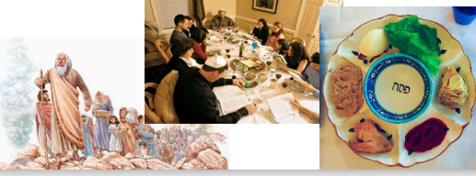
Year 4 – How do people show commitment to God?
Main Beliefs
Jews believe in one God. They also try to lie by the Ten Commandments. They include using God’s name with respect, remembering the Sabbath, respecting your parents and not lying or stealing. Jews believe God gave the Ten Commandments to Moses .
Symbols In the Christmas story The angels The star The wise men The gifts – gold, frankincense and myrrh The manger The stable Christingle The orange – the world The candle – light of the world The red ribbon – Jesus’ blood Four cocktail sticks - 4 corners of world Sweets or dried fruit – God’s gifts
Vocabulary Dozen
Covenant | A special promise
Shema | An important prayer for Jews
Torah | The Jewish holy book
Synagogue | Place of worship for Jewish people
Rabbi | Jewish religious leader and teacher
Hebrew | A language used by Jewish people
Ner Tamid | A light that hangs above the Ark where the Torah is kept that is not allowed to go out
Kashrut | The special dietary rules followed by Jews
Kosher | Following Jewish laws of food
Worship | Love or devotion shown to a being or an object considered sacred.
Eucharist | The consecrated bread and wine used in Holy Communion.
Holy Communion | Any of various Cristian rites in which bread and wine are consecrated and distributed as the body and blood of Jesus Christ.
Judaism
Judaism began around 4000 years ago in the idle East; Jerusalem is a place where many Jews go on pilgrimage.
Jewish people go to the synagogue to worship. The most important part of the synagogue is the Ark; This is where the Torah is kept. The Torah is treated with great respect. Jews are not allowed to touch it. Jews believe there is one God who every Jew can have a relationship with. Jewish history begins with the Covenant between God and Abraham.
The most significant part of the nativity story for Christians.

